Slide 1


AKUAPEM NORTH MUNICIPAL ASSEMBLY
PRESENTATION OF 2026 DRAFT COMPOSITE BUDGET
OCTOBER, 2025

Slide 2


POPULATION
The Akuapem North District Assembly was established in 1988 by Legislative Instrument (L.I.) 1430 in pursuance of the Government’s Decentralization Policy and Local Government Reform Policy with Akropong as its capital. The elevation from District to Municipal was in 2012 by L.I. 2041 and the Okere District was separated from Akuapem North by L.I 2306.
From the 2021 population and housing census it was established that the population of the Municipal was about 105,315 with an annual population growth rate of 1%,the estimated population of the municipal for 2024 is 108,506 and 109,613 for 2025

Slide 3


STRATEGIC OVERVIEW OF AKUAPEM NORTH MUNICIPAL ASSEMBLY
The Municipal Assembly exists to improve the living conditions of the people through efficient mobilization and equitable distribution of resources to enhance local development
To be among the top 10 Assemblies in the provision of world class Municipal works and service.

Slide 4
CORE FUNCTIONS
The core functions of the Assembly as stated in Section 12 of the Local Governance Act 936, 2016 include exercising executive, deliberative and legislative functions. Specifically
Initiate and prepare district development plans and settlement structure plans in the manner prescribed by the Commission.
Ensure that the district development plans and the settlement structure plans are prepared with the full participation of the local community;
Carry out studies on
(i) development planning matters in the district that include studies on economic, social, spatial,
environmental, sectorial and human settlement issues and policies.
(ii) the mobilization of human and physical resources for development in the district
Initiate and co-ordinate the process to plan programmes, budget and implement a district development plan, programme or project;
Provide the Commission with the data and information that the Commission may require
Monitor and evaluate the development policies, programmes and projects in the district.
Synthesize the policy proposals on development planning in the district into a comprehensive framework for the economic, social and spatial development of the district including human settlements and ensure that the policy proposals and projects are in conformity with the principles of sound environmental management
Integrate and ensure that sector and spatial policies, plans, programmes and projects of the district are compatible with each other and with national development objectives issued by the Commission

Slide 5
POLICY OBJECTIVES
Improve post-harvest management
Support entrepreneurs and MSME development Enhance equitable access to, and participation in quality education at all levels Ensure equitable, affordable, and quality Universal Health Coverage (UHC) for all. Improve access to safe, reliable and sustainable water supply services for all. Enhance access to improved and sustainable environmental sanitation services Promote efficient and sustainable waste management Promote effective maintenance culture Improve decentralized Planning Improve public access to development information

Slide 6

STRATEGIC OVERVIEW CONT’D
ECONOMY
Farming remains the major pre-occupation of the people. Crops mostly cultivated are cassava, plantain, cocoyam, maize and vegetables, Gari and palm oil processing are the only agro-processing ventures
Akwapim North Municipality has one(1) Government Hospital, one (1) Private hospital, (31) community-based health planning and services (CHPS) compounds and 4 clinics,
The urban centers within the Municipality are Mostly clean with refuse being managed by the Assembly through contracted service providers. Refuse containers are regularly carried to the final disposal site at Kwamoso.
Agriculture being the mainstay of the economy of the Municipality offers employment to about 60% of the population. The Municipality is endowed with arable land suitable for cultivation of cassava, Plantain, maize, pawpaw, oranges and vegetables such as cabbage, lettuce, carrots, sweet green pepper, okra and garden eggs. Livestock rearing is also done in the area.
HEALTH SERVICES
SANITATION
AGRICULTURE

Slide 7

STRATEGIC OVERVIEW CONT’D
Roads in the Municipality can be classified into 3 categories- first, second and third. The first represents asphalt, second bitumen surfacing and the third gravelled roads. The first class roads start from Obosomase through Mamfe to Akropong. The second class roads include the urban roads in the major towns, namely Akropong, Mampong, Mamfe etc. The third class roads include the feeder roads, namely Adawso, Mangoase, Pantoase, Okorase, Osabene and Kentenkren
The Municipality lies in the Semi-deciduous forest zone and temperatures range between 20 degrees Celsius and 32 degrees Celsius in March averaging 23.88 Degrees Celsius. The soil supports farming activities and the presence of rocks allow for stone quarry activities which are sources of income for some people.
ROADS
ENVIRONMENT
TOURISIM
The Akuapem North Municipality is endowed with seven (7) interesting tourist attractions. These include Adom waterfalls at Obosomase, Aminapa waterfall at Akropong. There is also the first Training College in West Africa, the Presbyterian College Education, Akropong. The Obom slave cave and ancient slave route at Obom, the over 50 year old six-in-one palm tree at Saforo and the famous Tetteh Quarshie Cocoa Farm at Mampong, among other notable tourist sites.

Slide 8


STRATEGIC OVERVIEW CONT’D
EDUCATION
The Municipality has all the levels of Education – basic, second cycle and tertiary; with quite a number being privately owned: The public institutions constitute 75% whilst the private institutions constitute 25%.
Kindergarten 160
Primary 161
JHS 96
SHS 12
Vocational/Technical 1
Tertiary 4
There are (3) three special schools in the Municipality as indicated below:
SPECIAL SCHOOLS LOCATION
School for the Blind Akropong
Demonstration School for the Deaf Mampong
Secondary Technical School for the Deaf Mampong

Slide 9
KEY DEVELOPMENT ISSUES
The key development issues in Akuapem North include;
Poor road network
Poor sanitation and environmental management.
Poor educational infrastructure.
High Unemployment among the youth .

Slide 10
FINANCIAL PERFORMANCE - REVENUE
REVENUE PERFORMANCE- IGF ONLY
ITEM | 2023 |  | 2024 |  | 2025
 | Budget GHC | Actual GHC | Budget GHC | Actual GHC | Budget GHC | Actual GHC | % perf. as at Sept | %perf. as per Items as at Sept
Property Rate | 87,500.00 | 131,988.98 | 650,000.00 | 413,464.10 | 500,000.00 | 335,545.82 | 67.11 | 12.71
Basic Rate | 3,000.00 | 1,532.00 | 1,000.00 | 915.00 | 1,000.00 | 985.00 | 98.5 | 0.04
Fees | 185,000.00 | 443,014.00 | 445,000.00 | 420,018.50 | 498,500.00 | 341,753.00 | 68.56 | 12.95
Fines | 35,000.00 | 15,611.50 | 7,000.00 | 9,299.00 | 9,000.00 | 8,600.00 | 95.56 | 0.33
Licenses | 302,000.00 | 269,967.08 | 1,898,000.00 | 1,860,562.62 | 616,000.00 | 381,122.75 | 61.87 | 14.44
Land | 1,268,432.84 | 1,284,588.50 | 1,295,432.84 | 1,455,435.55 | 2,550,000.00 | 1,536,257.00 | 60.25 | 58.21
Rent | 45,000.00 | 25,312.30 | 18,000.00 | 26,252.00 | 30,000.00 | 34,819.00 | 116.25 | 1.32
Investment | 0 | 0 | 0 | 0 | 0 | 0 | 0 | 0
Sub-Total | 1,925,932.84 | 2,172,014.36 | 4,314,432.84 | 4,185,946.77 | 4,204,500.00 | 2,639,082.57 | 62.77 | 62.77
Royalties | 0 | 0 | 0 | 0 | 0 | 0 | 0
TOTALS | 1,925,932.84 | 2,172,014.36 | 4,314,432.84 | 4,185,946.77 | 4,204,500.00 | 2,639,082.57 | 62.77 | 62.77

Slide 11
REVENUE PERFORMANCE- ALL REVENUE SOURCES
ITEM | 2023 |  | 2024 |  | 2025
 | Budget GHC | Actual GHC | Budget GHC | Actual GHC | Budget GHC | Actual as at sept | % perf. as at sept
IGF | 1,925,932.84 | 2,172,014.36 | 4,314,432.84 | 4,185,946.77 | 4,204,500.00 | 2,639,082.57 | 62.77
Comp. of Employees | 7,000,000.00 | 6,427,671.68 | 8,120,691.60 | 8,120,691.60 | 9,571,076.25 | 7,178,307.21 | 75.00
G/S Transfer | 89,000.00 | 58,464.38 | 143,000.00 | 0 | 150,000.00 | 51,028.88 | 34.02
Assets Transfer | 25,180.00 | 0 | 0 | 0 | 0 | 0 | 0
DACF-ASSEMBLY | 1,690,155.00 | 1,060,830.75 | 2,106,000.00 | 1,159,724.72 | 18,684,633.51 | 6,059,053.68 | 32.43
DACF-PWD | 80,000.00 | 111,808.95 | 300,000.00 | 162,916.66 | 320,000.00 | 219,414.78 | 68.57
DACF- MP | 450,000.00 | 379,657.72 | 800,000.00 | 649,214.41 | 720,000.00 | 810,723.58 | 112.60
DACF-RFG | 761,800.00 | 0 | 1,848,663.00 | 1,848,663.00 | 1,418,206.00 | 0 | 0
MAG | 59,099.00 | 59,098.63 | 0 | 0 | 0 | 0 | 0
UNICEF | 35,000.00 | 35,000.00 | 35,000.00 | 35,000.00 | 35,000.00 | 0 | 0
DRIP | 0 | 0 | 1,500,000.00 | 500,000.00 | 1,500,000.00 | 0 | 0
ASSEMBLY MEMBERS ALLOW. | 0 | 0 | 0 | 0 | 561,600.00 | 128,960.00 | 22.96
TOTAL | 12,106,011.84 | 10,304,546.47 | 19,167,787.44 | 16,662,157.16 | 37,165,015.76 | 17,097,631.81 | 46.00

Slide 12
Financial Performance – Expenditure Cont’d.
EXPENDITURE PERFORMANCE (ALL DEPARTMENTS) IGF ONLY
Expenditure | 2023 |  | 2024 |  | 2025
 | Budget GHC | Actual GHC | Budget GHC | Actual GHC | Budget GHC | Actual as at Sept GHC | % age Perf. as at Sept
Compensation of Employees | 404,105.00 | 319,562.68 | 425,000.00 | 242,724.14 | 465,000.00 | 293,545.76 | 63.13
Goods and Services | 1,136,641.28 | 1,473,969.57 | 2,261,432.84 | 2,796,319.84 | 2,898,600.00 | 2,283,679.47 | 78.79
Assets | 385,186.56 | 267,231.00 | 1,628,000.00 | 1,278,435.29 | 840,900.00 | 55,500.00 | 6.60
Total | 1,925,932.84 | 2,060,763.25 | 4,314,432.84 | 4,317,479.27 | 4,204,500.00 | 2,632,725.23 | 62.62

Slide 13
Expenditure By Budget Programme And Economic Classification-all Funding Sources as at September 2025
EXPENDITURE PERFORMANCE (ALL DEPARTMENTS) ALL FUNDING SOURCES
Expenditure | 2023 |  | 2024 |  | 2025
 | Budget GHC | Actual GHC | Budget GHC | Actual GHC | Budget GHC | Actual as at Sept GHC | % age Performance as at Sept
Compensation of Employees | 7,404,105.00 | 6,747,234.36 | 8,545,691.6 | 8,363,415.74 | 10,597,676.25 | 7,596,652.97 | 71.68
Goods and Services | 2,568,586.84 | 2,301,470.89 | 6,045,432.84 | 5,456,180.46 | 8,250,051.90 | 4,130,664.14 | 50.07
Assets | 2,133,319.96 | 1,203,225.35 | 4,576,663.00 | 3,094,289.61 | 18,317,287.61 | 626,500.00 | 3.42
Total | 12,106,011.80 | 10,251,930.65 | 19,167,787.44 | 16,913,885.81 | 37,165,015.76 | 12,353,817.34 | 33.24

Slide 14
Expenditure By Budget Programme And Economic Classification-all Funding Sources as at September 2025
BUDGET PROGRAMME | AMOUNT GH¢
 | BUDGET | COMPENSATION OF EMPLOYEES | GOODS & SERVICE | CAPITAL EXPENDITURE | TOTAL
Management and Administration | 15,748,598.85 | 7,596,652.97 | 2,709,126.23 | 129,500.00 | 10,435,279.20
Social Services Delivery | 6,326,390.06 | 0 | 999,198.14 | 0 | 999,198.14
Infrastructure Delivery and Management | 14,785,417.61 | 0 | 397,340 | 497,000.00 | 894,340.00
Economic Development | 295,109.09 | 0 | 25,000.00 | 0 | 25,000.00
Environmental Management | 9,500.00 | 0 | 0 | 0 | 0
TOTAL | 37,165,015.76 | 7,596,652,97 | 4,130,664.14 | 626,500.00 | 12,353,817.34

Slide 15
2025 Key Projects and Programmes from all funding sources (Liabilities)
No | Name of Project / Programme | Amount budgeted | Actual Payment as at Sept, 2025 | Outstanding Payment
1. | Construction of 6Unit Classroom Block Office and Store at Aboabo | 325,000.00 | 325,000.00 | 0
2 | Procurment of Furniture and Fittings | 50,000.00 | 50,000.00 | 0
3 | Carry out District Wide Fumigation Exercise | 209,299.66 | 209,299.66 | 0
4 | Sanitation Improvement Package | 261,625.00 | 261,625.00 | 0
5 | Evacution of refuse dumps | 483,000.00 | 483,000.00 | 0
 | TOTALS | 1,328,924.66 | 1,328,924.66 | 0

Slide 16


NON-FINANCIAL PERFORMANCE BY PROGRAMMES

Slide 17
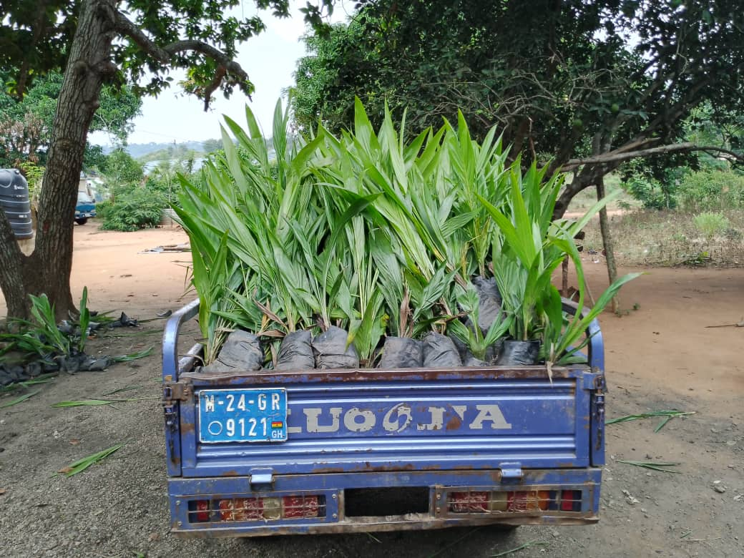
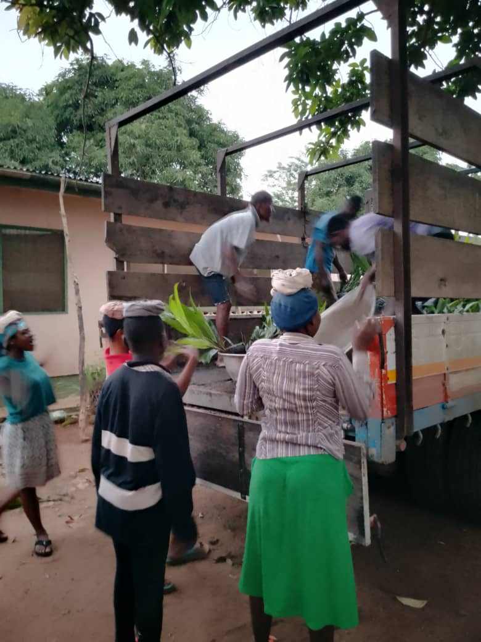
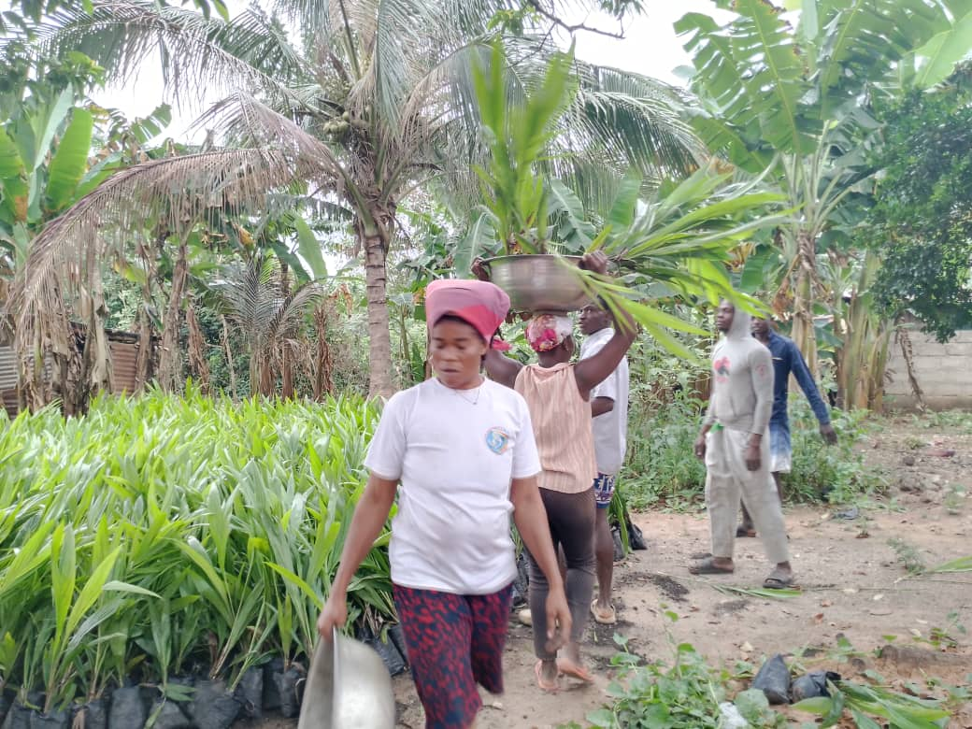
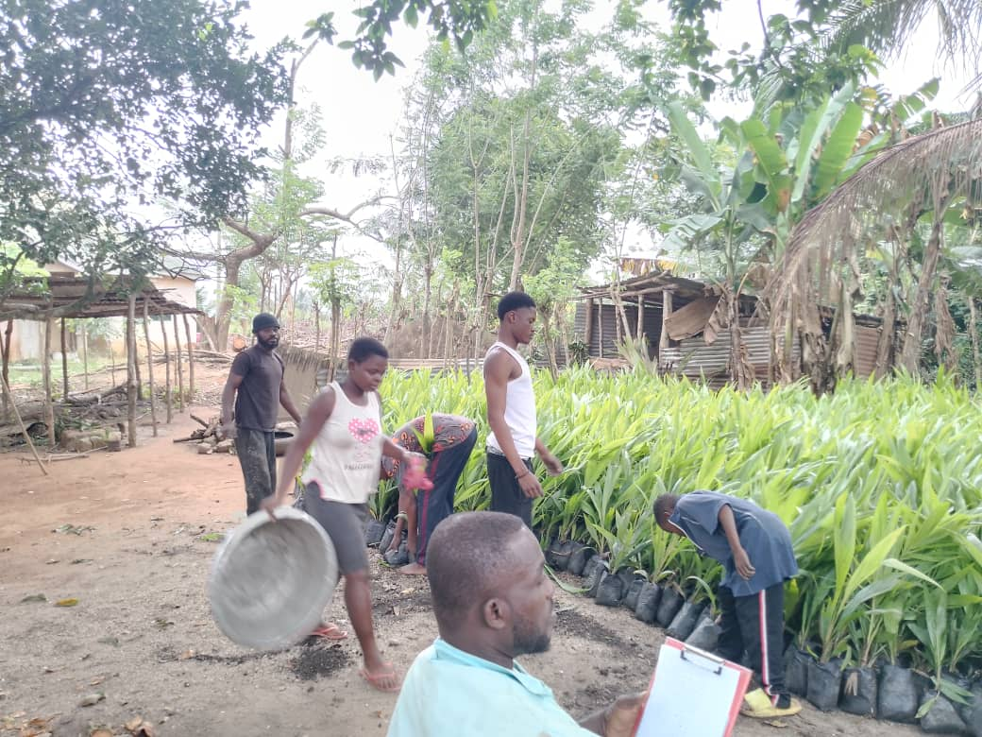
Key Achievements (2025)
Distributed 27,732 Oil Palm seedlings to 12 farmers to rehabilitate 8.4ha degraded farmlands for enhanced economic prospect of farmers.

Slide 18
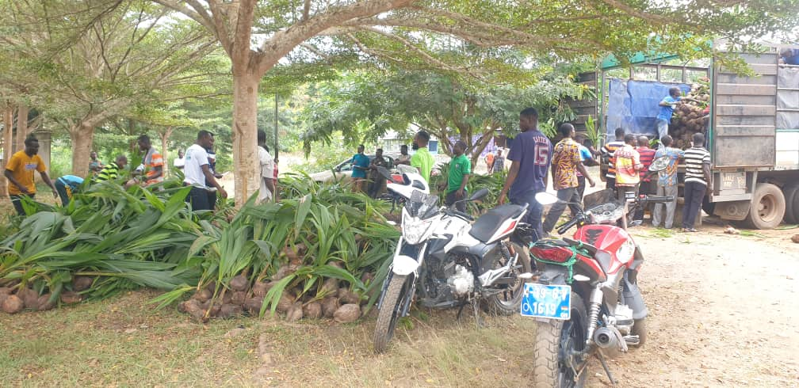
Key Achievements (2025)
Distributed 1,500 coconut seedlings to 12 farmers to rehabilitate 8.4ha degraded farmlands for enhanced economic prospect of farmers.

Slide 19
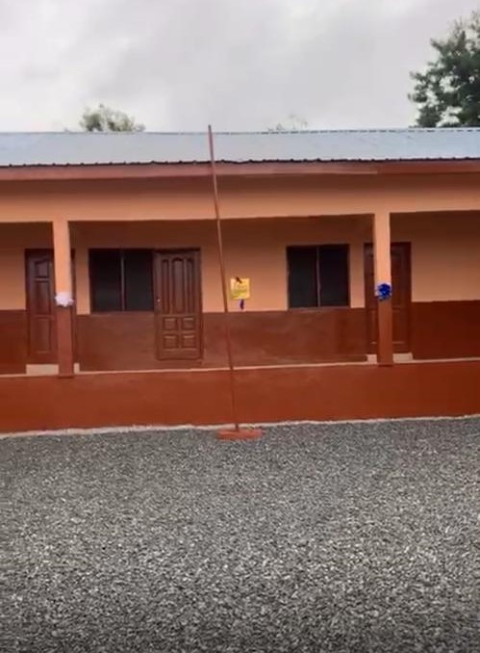
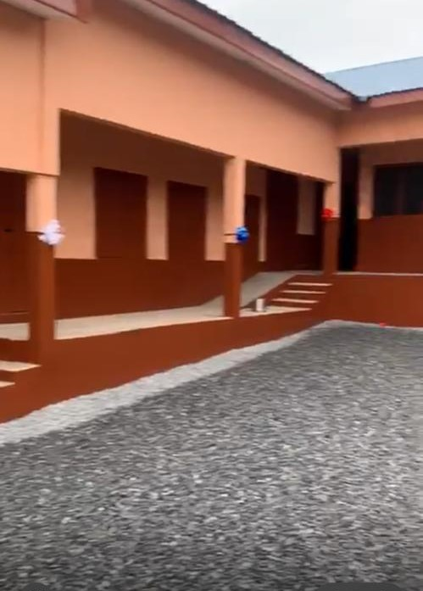
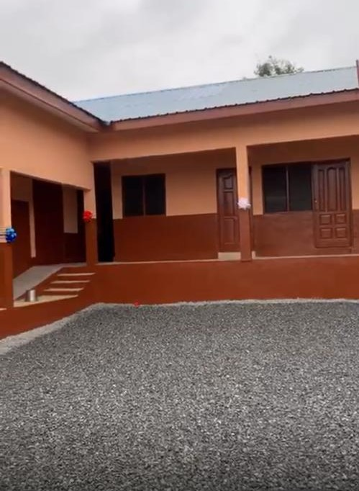
Key Achievements (2025)
Constructed 6Unit Classroom Block Office and Store at Aboabo

Slide 20
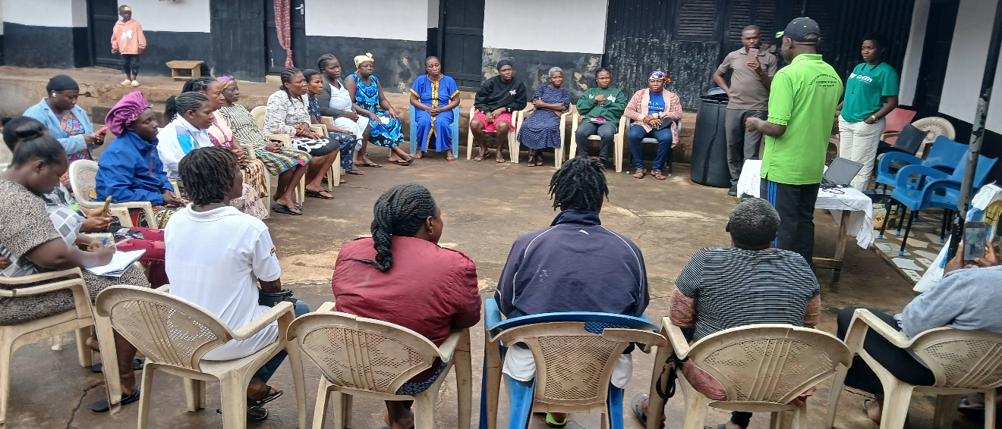
Key Achievements (2025)
TRAINed parent supports group ON MUSHROOM AND SNAIL PRODUCTION AT LARTEH

Slide 21
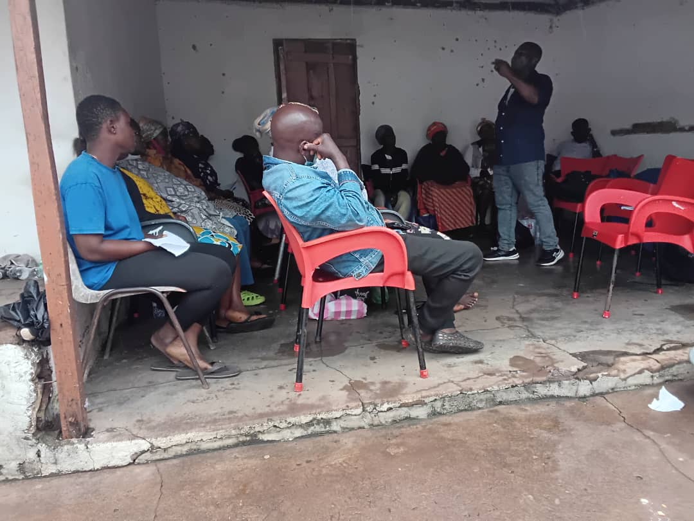
Key Achievements (2025)
TRAINed parent supports GROUP ON VEGETABLES PRODUCTION AT TUTU

Slide 22
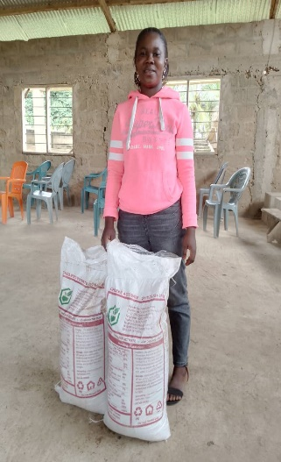
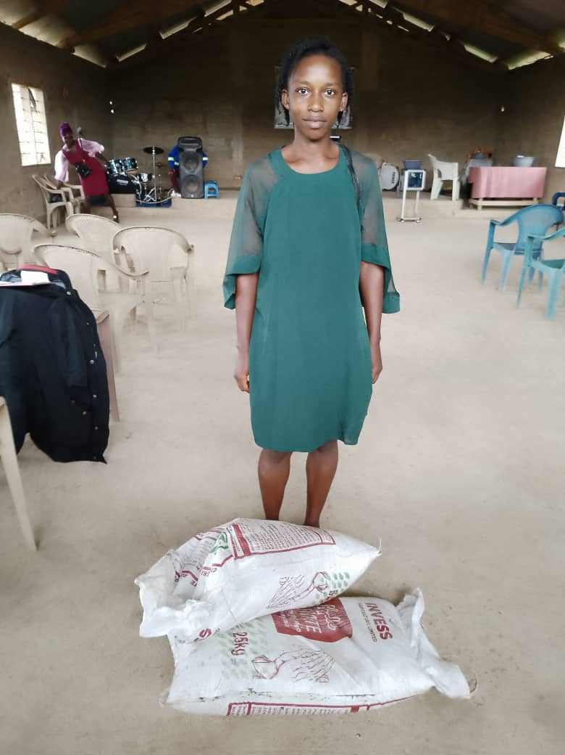
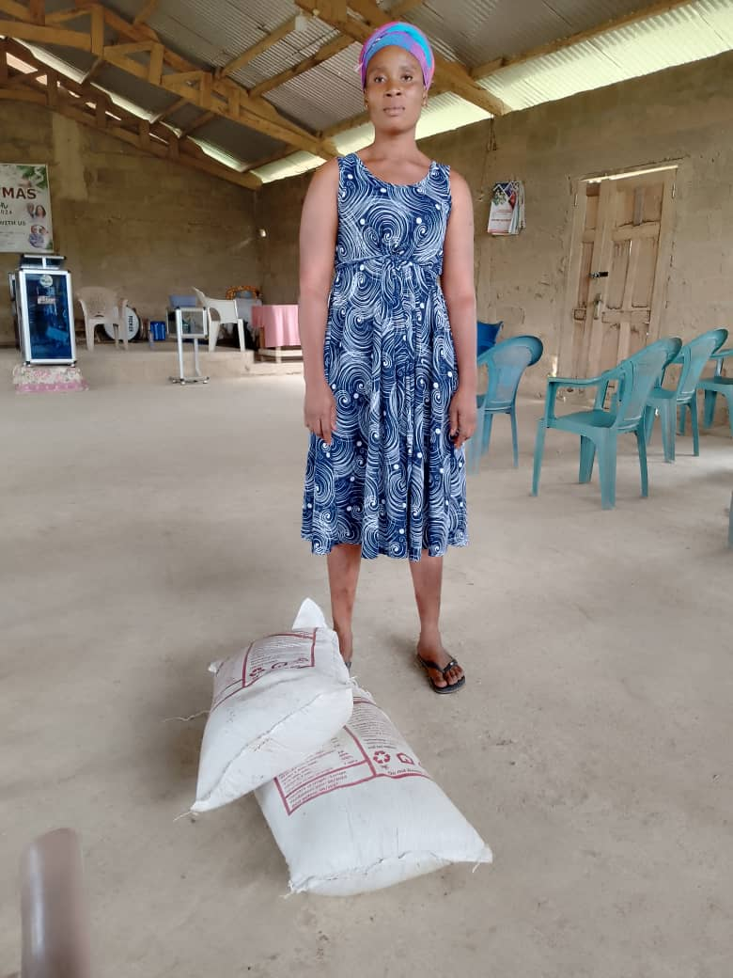
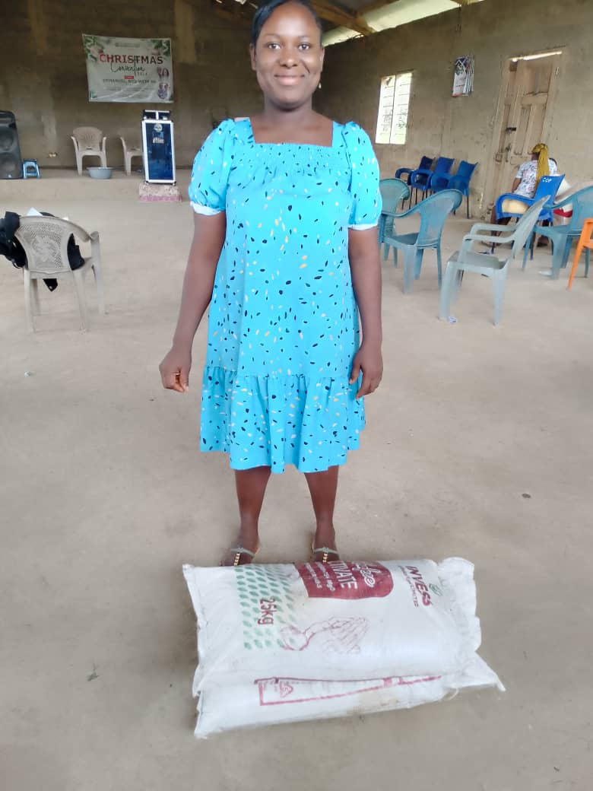
Key Achievements (2025)
DISTRIBUTED COMPOST, NPK FERTILIZERS, WEEDICIDES AND PESTICIEDES

Slide 23
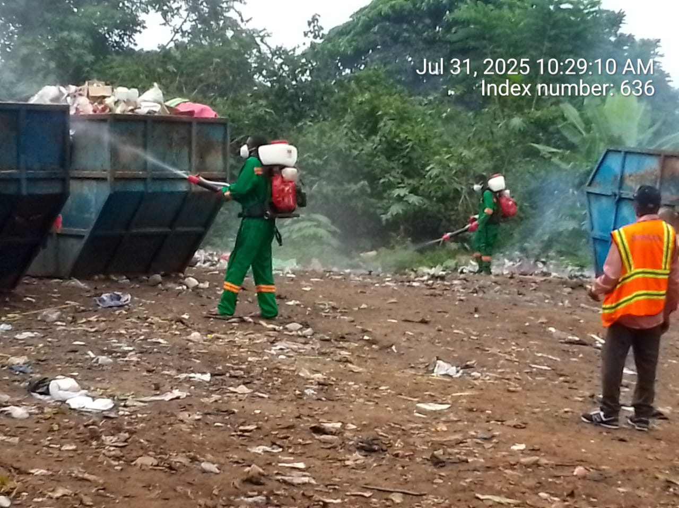
Key Achievements (2025)
FUMIGATED AND DISINFECTED SOME SELECTED COMMUNITIES WITHIN THE MUNICIPALITY

Slide 24
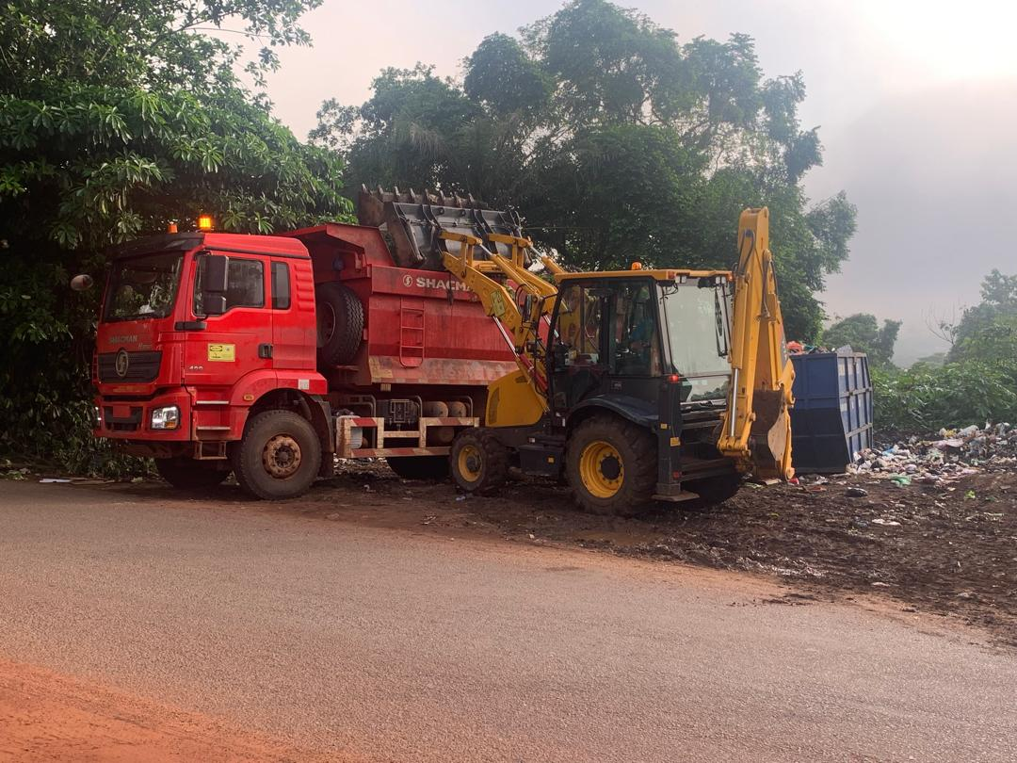
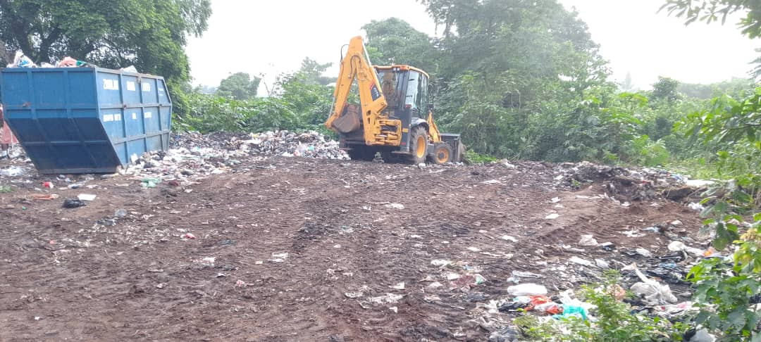
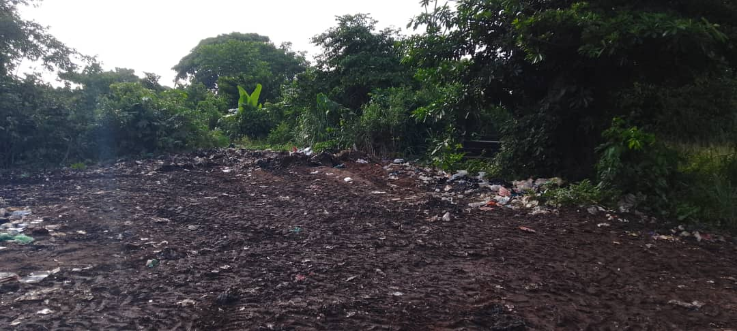
Key Achievements (2025)
EVACUATED REFUSE AT ADWASO, MAMPONG AND AKROPONG

Slide 25
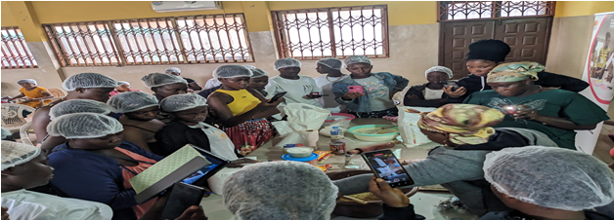
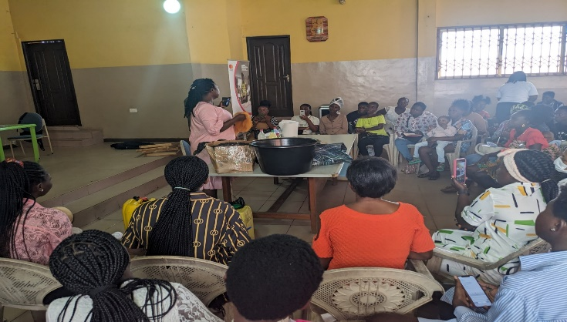
Key Achievements (2025)
TRAINED THE YOUTH ON PASTRY MAKING AND SOAP MAKING

Slide 26
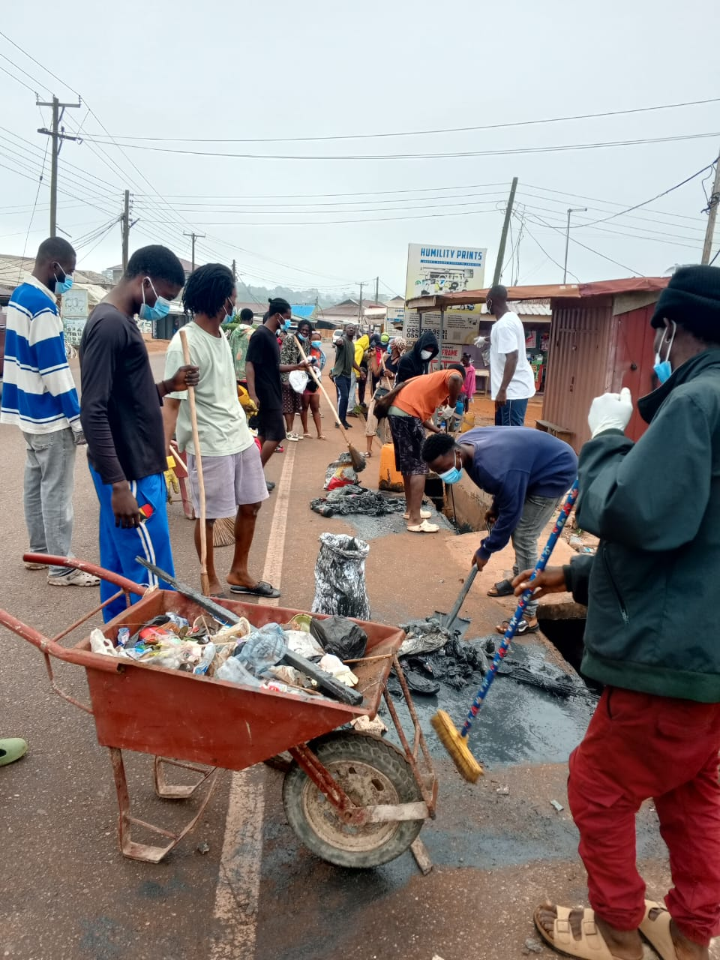
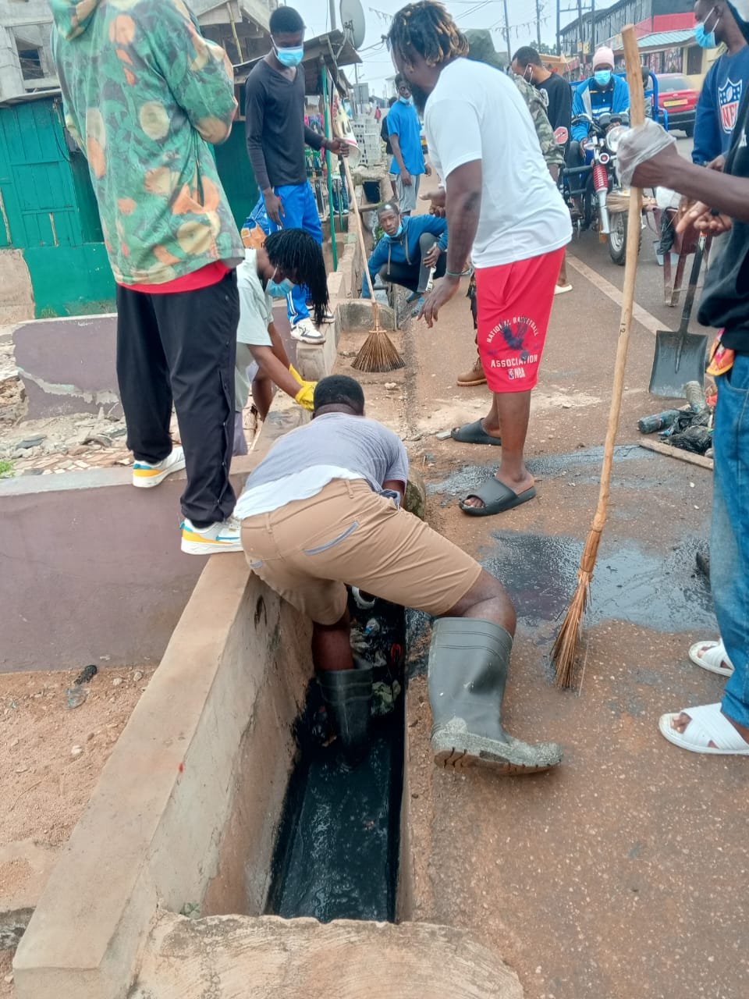
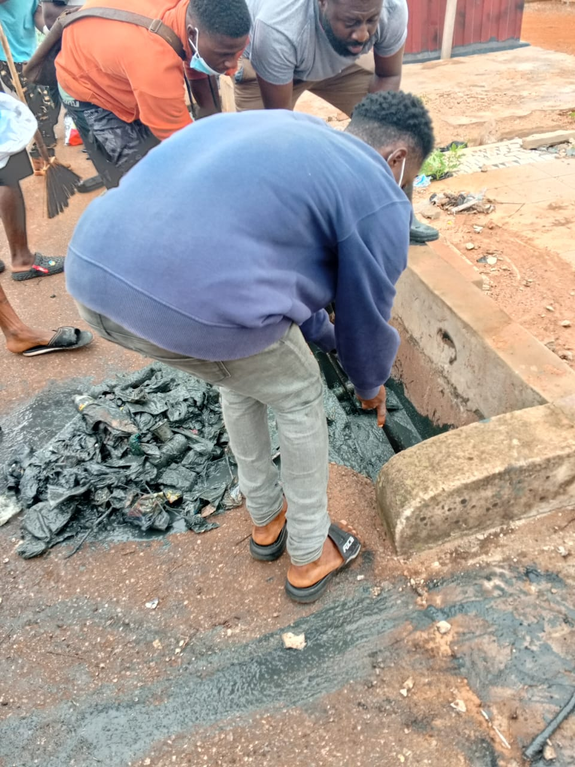
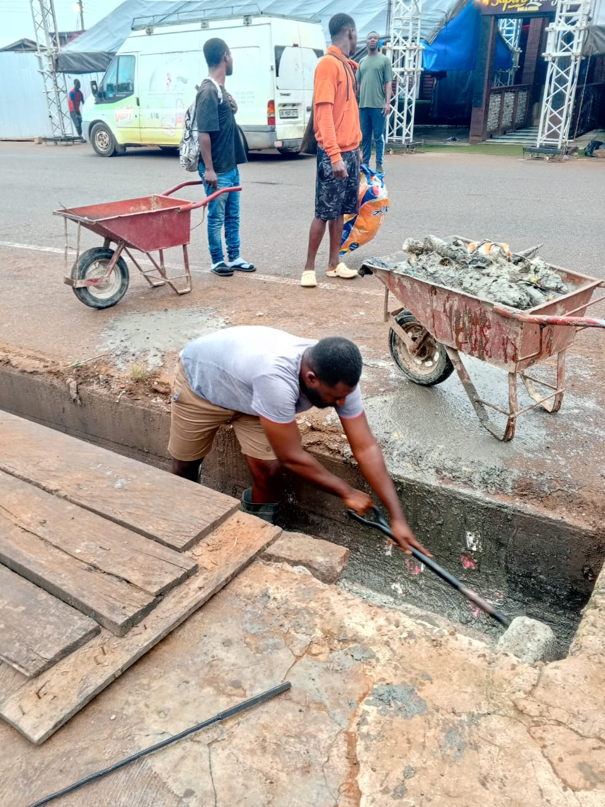
Key Achievements (2025)
ORGANISED CLEAN UP EXERCISE WITHIN THE MUNICIPALITY.

Slide 27
Policy Outcome Indicators and Targets
Outcome Indicator | Outcome Indicator Description | Unit of Measurement | Previous year’s performance (2024) |  | Current year’s Actual Performance (2025)
Reduction in Average travel time on urban roads | Reduced travel time on urban roads | Travel time on urban roads | 70km/hr | 58km/hr | 72km/hr | 55km/hr
Percentage of vulnerable people empowered | Vulnerable people protected against livelihood risks | Year on year percentage change in supported vulnerable people | 62% | 48% | 60% | 74%
Improved efficiency and output of Agricultural productivity | Increased Agricultural productivity | Percentage growth in Agricultural Produvctivity | 10.25% | 8.8% | 10% | 8.92%
Percentage of students enrolled in Eduactional Institutions | Improved gross admission ratio (GAR) | Percentage of school going age children in school | 90.05% | 89.5% | 92% | 90%

Slide 28
Sanitation Budget Performance
Liquid Waste
No. | Name of Activity/Project | Budget | Actuals as at September, 2025
1. | Regular dislodgement of all institutions Laterine | 30,000.00 | 0
2. | Renovation of Toilet Facility at old Assembly | 35,000.00 | 0
 | Total | 65,000.00 | 0
Solid Waste
No. | Name of Activity/Project | Budget | Actuals as at September, 2025
1 | Evacuation of refuse dumps and maintenance of final dumping site at Kwamoso | 621,400.00 | 483,000.00
2 | Carry out District wide Fumigation excercise - Municipality wide | 418,600.00 | 209,299.66
3 | Sanitation Improvement Package (SIP) | 523,250.00 | 261,624.92
4 | Procurement of 2 No. Skip containers at Akropong and Okorase | 100,000.00 | 0
5 | Procurement of Sanitary Tools and Equipment | 60,000.00 | 10,000.00
 | TOTAL | 1,723,250.00 | 963,924.58

Slide 29
DP Supported Programmes (eg. Child Right, Protection and Promotion, Safety Net etc.)
Child Right and Protection
No | Name of Activity/Project | Budget | Actual as at Sept, 2025
1 | Provide care and support for 20 Orphans and vulnerable children with community-based services | 2,000.00 | 0
2 | Provide care, support, counselling and supervision services to 50 distressed families, patients and vulnerable children | 3,500.00 | 0
3 | Sensitize and guide schools’ children on Academic performance and career progression through information of school learning club on future career selection | 1,000.00 | 0
4 | Ensure effective implementation of child welfare, family and juvenile Tribunal activities | 1,000.00 | 0
5 | Sensitize 30 communities on social issues that posed threat to the wellbeing of people especially children | 24,500.00 | 0
6 | Inspect, register and renew 20 Early childhood Development centers | 1,500.00 | 0
7 | Conduct sensitization on Gender based violence and gender stereotypes and coordinate GBV cases across 10 communities | 1,500.00 | 0
 | Total | 35,000.00 | 0.00

Slide 30


Slide 31
MMDA Adopted Policy Objectives for 2026
FOCUS AREA | ADOPTED POLICY OBJECTIVES | BUDGET ALLOCATION
ECONOMIC DEVELOPMENT
Agriculture and Agribusiness Development | Improve post-harvest management | 1,540,475.37
Ensure Private sector Development | Support entrepreneurs and MSME development | 6,000.00
SOCIAL DEVELOPMENT
Education and Training | Enhance equitable access to, and participation in quality education at all levels | 8,183,536.98
Health and Health Services | Ensure equitable, affordable, and quality Universal Health Coverage (UHC) for all. | 5,169,459.83
Water , Environmental Sanitation and hygiene | Improve access to safe, reliable and sustainable water supply services for all. Enhance access to improved and sustainable environmental sanitation services Promote efficient and sustainable waste management | 5,003,014.08
ENVIRONMENT AND HUMAN SETTLEMENTS DEVELOPMENT
Infrastructure maintenance | Promote effective maintenance culture | 20,642,051.53
Sub-Total

Slide 32
MMDA Adopted Policy Objectives for 2026
FOCUS AREA | ADOPTED POLICY OBJECTIVES | BUDGET ALLOCATION
GOVERNANCE AND INSTITUTIONAL DEVELOPMENT
Local Governance and Decentralization | Improve decentralized Planning | 10,000,000.28
Development Communication | Improve public access to development information | 401,364.00
TOTALS |  | 50,945,902.07

Slide 33
Policy Outcome Indicators and Targets
Policy Outcome Indicators and Targets
Outcome Indicator | Outcome Indicator Description | Unit of Measurement | Baseline (2024) |  | Current year (2025) |  | Budget year (2026) | Indicative year (2027) | Indicative year (2028) | Indicative year (2029)
 |  |  | Target | Actual | Target | Actual as at Sept | Target | Target | Target | Target
Improved efficiency and output of Agricultural productivity | Increased Agricultural productivity | Percentage growth in Agricultural productivity | 10% | 10% | 10% | 8.92% | 10% | 10% | 10% | 10%
Percentage of students enrolled in educational institutions | Improved Gross Admission Ratio (GAR) | Percentage of school going age children in school | 90.2% | 89.3% | 92% | 90% | 93% | 93% | 93% | 93%
Reduction in Average travel time on urban roads | Reduced travel time on urban roads | Travel time on urban roads | 70km/hr | 58km/hr | 72km/hr | 55km/hr | 75km/hr | 80km/hr | 84km/hr | 90km/hr
Percentage of vulnerable people empowered | Vulnerable people protected against livelihood risks | Year on year percentage change in supported vulnerable people | 62% | 48% | 60% | 74% | 75% | 75% | 75% | 75%

Slide 34
2026-2029 Revenue Projections – IGF Only
Policy Outcome Indicators and Targets
ITEM | 2025 |  | 2026 | 2027 | 2028 | 2029
 | Budget | Actual as at September | Projection | Projection | Projection | Projection
Property Rate | 500,000.00 | 335,545.82 | 550,000.00 | 605,000.00 | 665,500.00 | 732,050.00
Basic Rates | 1,000.00 | 985.00 | 1,100.00 | 1,210.00 | 1,331.00 | 1,464.10
Fees | 498,500.00 | 341,753.00 | 461,450.00 | 507,595.00 | 558,354.50 | 614,189.95
Fines | 9,000.00 | 8,600.00 | 4,300.00 | 4,730.00 | 5,203.00 | 5,723.30
Licence | 616,000.00 | 381,122.75 | 676,500.00 | 744,150.00 | 818,565.00 | 900,421.50
Land | 2,550,000.00 | 1,536,257.00 | 2,805,000.00 | 3,085,500.00 | 3,394,050.00 | 3,733,455.00
Rent | 30,000.00 | 34,819.00 | 40,000.00 | 44,000.00 | 48,400.00 | 53,240.00
Investment | 0 | 0 | 0 | 0 | 0 | 0
Sub-Total | 4,204,500.00 | 2,639,082.57 | 4,538,350.00 | 4,992,185.00 | 5,491,403.50 | 6,040,543.85
Royalties | 0 | 0 | 0 | 0 | 0 | 0
Total | 4,204,500.00 | 2,639,082.57 | 4,538,350.00 | 4,992,185.00 | 5,491,403.50 | 6,040,543.85

Slide 35
2026-2029 Revenue Projections – All Revenue Sources
ITEM | 2025 |  | 2026 | 2027 | 2028 | 2029
 | Budget | Actual as at September | Projection | Projection | Projection | Projection
IGF | 4,204,500.00 | 2,639,082.57 | 4,538,350.00 | 4,992,185.00 | 5,491,403.50 | 6,040,543.85
Compensation of Employees | 9,571,076.25 | 7,178,307,21 | 9,873,954.96 | 10,861,350.46 | 11,947,485.50 | 13,142,234.05
Goods and Services Transfer | 150,000.00 | 51,028.88 | 111,639.00 | 122,802.90 | 135,083.19 | 148,591.51
Assets Transfer | 0 | 0 | 0 | 0 | 0 | 0
DACF-Assembly | 18,684,633.51 | 6,059,053.68 | 26,857,167.99 | 29,542,884.79 | 32,497,173.27 | 35,746.890.60
DACF-MP | 720,000.00 | 810,723.58 | 5,000,000.00 | 5,500,000.00 | 6,050,000.00 | 6,655,000.00
DACF-PWD | 320,000.00 | 219,414.78 | 877,659.12 | 965,425.03 | 1,061,967.54 | 1,168,164.29
DACF-RFG | 1,418,206.00 | 0 | 1,418,206.00 | 1,560,026.60 | 1,716,029.26 | 1,887,632.19
Secondary Cities | 0 | 0 | 0 | 0 | 0 | 0
UNICEF | 35,000.00 | 0 | 20,125.00 | 20,125.00 | 20,125.00 | 20,125.00
DRIP | 1,500,000.00 | 0 | 1,500,000.00 | 1,650,000.00 | 1,815,000.00 | 1,996,500.00
ASSEMBLY MEMBERS ALLOWANCE | 561,600.00 | 128,960.00 | 748,800.00 | 823,680.00 | 906,048.00 | 996,652.80
Total | 37,165,015.76 | 17,097,631.81 | 50,945,902.07 | 56,038,479.78 | 61,640,315.26 | 67,802,334.29

Slide 36
Expenditure By Budget Programme And Economic Classification-all Funding Sources
Policy Outcome Indicators and Targets
BUDGET PROGRAMME | GHC
 | COMPENSATION OF EMPLOYEES | GOODS & SERVICE | CAPITAL EXPENDITURE | TOTAL
Management and Administration | 6,180,313.92 | 3,232,145.36 | 956,270.00 | 10,368,729.28
Social Services Delivery | 2,463,319.68 | 4,250,322.66 | 13,321,942.70 | 20,035,585.04
Infrastructure Delivery and Management | 1,766,909.64 | 1,456,186.00 | 15,739,381.74 | 18,962,477.38
Economic Development | 1,027,268.28 | 519,207.09 | 0 | 1,546,475.37
Environmental Management | 0 | 32,635.00 | 0 | 32,635.00
TOTAL | 11,437,811.52 | 9,490,496.11 | 30,017,594.56 | 50,945,902.07

Slide 37
Key Projects For 2026 and Corresponding Cost and Justification
Policy Outcome Indicators and Targets
List all Projects | IGF (GHc) | GOG (GHc) | DACF (GHc) | DACF-RFG (GHc) | Other Donor (GHc) | Total Budget (GHc) | Justification- What do you intend to achieve with the programmes/projects and how does this link to your objectives?
Rehabilitate office buildings and structures | 100,000.00 |  | 50,000.00 |  |  | 150,000.00 | Effective maintenance culture promoted
Procure Furniture and Fittings (Cabinets, receptionist Desk,swivel chair and visitors chair). | 50,000.00 |  |  |  |  | 50,000.00 | Work effectiveness and efficiency enchanced
Renovate Attabui M/A and Aboabo M/A basic school(MP) |  |  | 105,000.00 |  |  | 105,000.00 | Provide conducive educational infrastructure to improve learning at all levels
Construct 1 No. CHPS Compound with fully furnished hospital bed and accessories (Osubetor )(MP) |  |  | 1,222,890.91 |  |  | 1,222,890.91 | Access to quality health care services improved at all levels
Renovate 2 No. CHPS compound -Tinkong, Konko(MP) |  |  | 320,000.00 |  |  | 320,000.00 | Access to quality health care services improved at all levels
Renovate the Dental department of TQMH Mampong(MP) |  |  | 170,000.00 |  |  | 170,000.00 | Access to quality health care services improved at all levels
Sub total | 150,000.00 |  | 1,867,890.91 |  |  | 2,017,890.91

Slide 38
Key Projects For 2026 and Corresponding Cost and Justification
Policy Outcome Indicators and Targets
List all Projects | IGF (GHc) | GOG (GHc) | DACF (GHc) | DACF-RFG (GHc) | Other Donor (GHc) | Total Budget (GHc) | Justification- What do you intend to achieve with the programmes/projects and how does this link to your objectives?
Procure 2 No. Skip containers at Akropong and Okorase |  |  | 100,000.00 |  |  | 100,000.00 | Environment sanitation improved
Complete payment for of 1 No. 12 seater W/C mechanised toilet facility at Mangoase, |  |  | 497,753.79 |  |  | 497,753.79 | Sanitation improved.
Renovate toilet facility at Old Assembly Block - Akropong | 35,000.00 |  |  |  |  | 35,000.00 | Sanitation improved.
Construct Market stores at Akropong |  |  |  | 1,375,635.00 |  | 1,375,635.00 | Local business enterprise promoted for local economic development
Drill 8 No. borehole with hand Pumps at Kokormo school, Adenya, Akokua, Akokua, Akwaani, Budu, Behenease, Attakrom, Bewase |  |  | 330,000.00 |  |  | 330,000.00 | Access to portable water improved in rural communities
Sub-tatoal | 35,000.00 |  | 927,753.79 | 1,375,635.00 | - | 2,338,388.79

Slide 39
Key Projects For 2026 and Corresponding Cost and Justification
List all Projects | IGF (GHc) | GOG (GHc) | DACF (GHc) | DACF-RFG (GHc) | Other Donor (GHc) | Total Budget (GHc) | Justification- What do you intend to achieve with the programmes/projects and how does this link to your objectives?
Drill and mechanize 16 No. borehole with high rise concrete stand with 2500 litres watertank at Kokormu School, Adenye, Akokua, Akwaani, Budu, Behenease, Ata krom, Bewase |  |  | 2,116,260.29 |  |  | 2,116,260.29 | Access to portable water improved in rural communities
Drill and mechanize 8 No. borehole with high rise concrete stand with 2500 litres watertank . |  |  | 1,000,354.92 |  |  | 1,000,354.92 | Access to portable water improved in rural communities
Construct 24 hour economic market (Lockable stores) at Adawso |  |  | 7,172,045.68 |  |  | 7,172,045.68 | Local business enterprise promoted for local economic development
Complete the payment for construction of Market at Nyamebekyere. |  |  | 882,916.75 |  |  | 882,916.75 | Local business enterprise promoted for local economic development
Construct and furnish of 2 No. 2-unit KG Block with office and store at Apasare, Pantoase |  |  | 1,864,363.80 |  |  | 1,864,363.00 | Provide conducive educational infrastructure to improve learning at all levels
Sub total |  |  | 12,153,024.69 |  |  | 12,153,024.69

Slide 40
Key Projects For 2026 and Corresponding Cost and Justification
Policy Outcome Indicators and Targets
List all Projects | IGF (GHc) | GOG (GHc) | DACF (GHc) | DACF-RFG (GHc) | Other Donor (GHc) | Total Budget (GHc) | Justification- What do you intend to achieve with the programmes/projects and how does this link to your objectives?
Construct Larteh M/A JHS with all ancillary facility(MP) |  |  | 600,000.00 |  |  | 600,000.00 | Provide conducive educational infrastructure to improve learning at all levels .
Repair and maintain 15 No. boleholes at Saforo, kwamoso quarters, Addo Nkwanta, Obom, Mampong Nkanta, Sokore, Adawso zongo, Adawso Attakro, Ntatiaman, Otareso, Ankwani, Pakro junction, Tetteh Kofi, Teiko, Gbolo kofi |  |  | 357,557.98 |  |  | 357,557.98 | Access to portable water improved in rural communities
Construct 1 No. JHS block with all ancillary facilities-Osabene(MP) |  |  | 600,000.00 |  |  | 600,000.00 | Provide conducive educational infrastructure to improve learning at all levels
Sub total |  |  | 1,557,557.98 |  |  | 1,557,557.98

Slide 41
List all Projects | IGF (GHc) | GOG (GHc) | DACF (GHc) | DACF-RFG (GHc) | Other Donor (GHc) | Total Budget (GHc) | Justification- What do you intend to achieve with the programmes/projects and how does this link to your objectives?
Procure 800 No. mono desk for JHS |  |  | 920,984.23 |  |  | 920,984.23 | Good learning environment created
Construct toilet facility – Kyiriahantan and Ewurede ( MP) |  |  | 405,000.00 |  |  | 405,000.00 | Sanitation improved
Construct 2 No. KG Block with ancillary facilities - Otareso, Mangoase(MP) |  |  | 1,100,000.00 |  |  | 1,100,000.00 | Provide conducive educational infrastructure to improve learning at all levels
Complete and furnish MCE bungalow |  |  | 35,604.61 |  |  | 35,604.61 | Key staff accomodated
Procure 200 No. Octagon tables and Chairs for KG schools |  |  | 26,494.89 |  |  | 26,494.89 | Good learning environment created
Purchase of 1 No. pick up | 906,270.00 |  |  |  |  | 906,270.00 | Monitoring and Evaluation system strengthened
Procure 1800 No. dual desk for public primary schools |  |  | 1,921,339.15 |  |  |  | Good learning environment created
Sub-Total | 906,270.00 |  | 4,409,422.88 |  |  | 5,315,692.88
Policy Outcome Indicators and Targets

Slide 42
Key Projects For 2026 and Corresponding Cost and Justification
Policy Outcome Indicators and Targets
List all Projects | IGF (GHc) | GOG (GHc) | DACF (GHc) | DACF-RFG (GHc) | Other Donor (GHc) | Total Budget (GHc) | Justification- What do you intend to achieve with the programmes/projects and how does this link to your objectives?
Construct 1 No. 6-unit primary classroom block at new Mangoase. |  |  | 1,000,354.92 |  |  | 1,000,354.92 | Provide conducive educational infrastructure to improve learning at all levels
Construct and furnish of 2No. CHPS Compound at Osabene and Mamfe |  |  | 2,868,818.26 |  |  | 2,868,818.26 | Access to quality health care services improved at all levels
Complete payment for of reshaping and gravelling of Adawso /Mangoase enclave road |  |  | 60,000.00 |  |  | 60,000.00 | Road network improved
Complete payment for of 0.6m U drain 3 No. 2 cell 0.6 pipe culvert and 10.1km paved road at Borehyem in Akropong |  |  | 1,398,242.00 |  |  | 1,398,242.00 | Road network improved
Sub-Total |  |  | 5,327,415.18 |  |  | 5,327,415.18
TOTALS | 1,091,270.00 | 0.00 | 26,243,065.43 | 1,375,635.00 | 0.00 | 28,709,970.43

Slide 43
Policy Outcome Indicators and Targets
Sanitation Budget
Liquid Waste
No | Name of Activity/Project | Budget
1 | Construct toilet facility – Kyiriahantan and Ewurede | 405,000.00
2 | Regular dislodging of all institutional latrine and public toilets | 60,000.00
3 | Complete payment for of 1No. 12-seater W/C mechanised toilet facility at Mangoase, | 497,753.79
 | Total | 962,753.79

Slide 44
Policy Outcome Indicators and Targets
Solid Waste
No | Name of Activity/Project | Budget
1 | Fumigation/Sanitation Activities | 600,083.18
2 | Procurement of 2 No. Skip containers at Akropong and Okorase | 100,000.00
3 | Procure Sanitary Tools and Equipment | 60,000.00
4 | Evacuate refuse dumps and maintenance of final dumping site at Kwamoso | 852,883.18
5 | Sanitation Improvement Package (SIP) | 654,733.18
6 | Purchase of cleaning Materials | 20,000.00
 | TOTAL | 2,287,699.54

Slide 45
Policy Outcome Indicators and Targets
DP Supported Programmes (eg. Child Right, Protection and Promotion, Safety Net etc.)
Child Right and Protection (UNICEF)
 | Name of Activity/Project | Budget
1 | Provide care, support, counselling and supervision services to 50 distress families and vulnerable children | 3,500.00
2 | Sensitize and guide children on academic performance and carer progression through formation of school learning club on future career selection | 1,000.00
3 | Ensure effective implementation of child welfare, family and juvenile tribunal activities | 1,000.00
4 | Provide care and support for 20 Orphans and vulnerable children with community-based services | 2,000.00
5 | Sensitize communities on social issues that posed threat to the wellbeing of children especially children | 9,625.00
6 | Inspect and register and renew 5 Early Childhood Development Centres | 1,500.00
 | TOTAL | 20,125.00

Slide 46
MARKET STORES
Policy Outcome Indicators and Targets
STORE NO. | NAME OF TENANTS | RENT PER ANNUM GH¢
LARTEH
ANMA/MKT/001 | YAW OTU | 300.00
ANMA/MKT/002 | ERNESTINA OFFEI | 300.00
ANMA/MKT/003 | COMFORT OHENEWAA | 300.00
ANMA/MKT/004 | ERNESTINA GYAMPO | 300.00
ANMA/MKT/005 | GRACE AKUA ASI OPARE | 300.00
ANMA/MKT/006 | ROSE OWARE | 300.00
ANMA/MKT/007 | MERCY L. AMPOFO | 300.00
ANMA/MKT/008 | NANA DARK ASAMOAH | 300.00
ANMA/MKT/009 | EVA ASABEA KYEIWA | 300.00
ANMA/MKT/010 | YAA KWAKYEWA | 300.00
ANMA/MKT/011 | VERA A. SIAW | 300.00
ANMA/MKT/012 | AKOI OWUSU | 300.00
ANMA/MKT/013 | COMFORT ADJEI | 300.00
ANMA/MKT/014 | MERCY AWUAH | 300.00
ANMA/MKT/015 | YAW ANSAH | 300.00
ANMA/MKT/016 | BRIGHT ADU OPOKU | 300.00
ANMA/MKT/017 | REVENUE OFFICE | 0
ANMA/MKT/018 | GEORGINA AGYARE | 300.00
ANMA/MKT/019 | CAROLINE WONTUMI | 300.00
ANMA/MKT/020 | ASIEDU LARBI | 300.00
ANMA/MKT/021 | JULIANA ADJEI | 300.00
ANMA/MKT/022 | JANET AMA ASANTEWAA | 300.00
SUB-TOTAL |  | 6,300.00

Slide 47
Policy Outcome Indicators and Targets
MARKET STORES -MANGOASE
STORE NO. | NAME OF TENANT | RENT PER ANNUM GH¢
ANMA/MKT/001 | VIVIAN AMISAH | 216.00
ANMA/MKT/002 | PAULINA SARPONG | 216.00
ANMA/MKT/003 | MADAM ADIZA | 216.00
ANMA/MKT/004 | LYDIA DJAN | 216.00
ANMA/MKT/005 | SIMON ASARE | 216.00
ANMA/MKT/006 | EVELYN AKOLE | 216.00
ANMA/MKT/007 | ADWOA MANSA | 216.00
ANMA/MKT/008 | CHRISTINA TOTSU | 216.00
ANMA/MKT/009 | SUSANA FOLI | 216.00
ANMA/MKT/010 | JULIANA OKYERE | 216.00
ANMA/MKT/011 | EMMA ASANTE | 216.00
ANMA/MKT/011 | WILLIAMS GATOR | 216.00
ANMA/MKT/012 | WILLIAM AGYEMAN | 216.00
ANMA/MKT/013 | AYEH MAXWELL | 216.00
ANMA/MKT/014 | DAWUDA FUSENI | 216.00
ANMA/MKT/015 | KWADWO EBERE | 216.00
ANMA/MKT/016 | KOFI AZREYA | 216.00
ANMA/MKT/017 | FULANI NOI | 216.00
ANMA/MKT/018 | LUCY NTIAMOAH | 216.00
ANMA/MKT/019 | FRANKLINA AMET) | 216.00
ANMA/MKT/020 | DZORKA PAULINA | 216.00
ANMA/MKT/021 | HAWUSATU AGYARKO | 216.00
ANMA/MKT/022 | JOHN PANTI SARQUAH | 216.00
ANMAMKT/023 | RITA DUGGBATEY | 216.00
SUB-TOTAL |  | 4,968.00

Slide 48
Policy Outcome Indicators and Targets
MARKET STORES -MANGOASE
ANMA/MKT/024 | EBENZER ASIRIFI | 216.00
ANMA/MKT/025 | BAANU YE DIS | 216.00
ANMA/MKT/026 | REGINA ADJEITEY | 216.00
ANMA/MKT/027 | MARK QUAYSON | 216.00
ANMA/MKT/028 | MOSES DONKOH | 216.00
ANMA/MKT/029 | GIFTY KONADU | 216.00
ANMA/MKT/030 | VIVIAN AREBERTEY | 216.00
TOTAL |  | 6,480.00

Slide 49
Policy Outcome Indicators and Targets
MARKET STORES -ADWASO
NO.S | NAME OF TENANTS | RENT PER ANNUM GH¢
ADWASO
ANMA/MKT/001 | JOOJO ASANTE | 300.00
ANMA/MKT/002 | REVENUE OFFICE | 0
ANMA/MKT/003 | ENVIRONMENTAL OFFICE | 0
ANMA/MKT/004 | SOLOMON IDRUSSU | 300.00
ANMA/MKT/005 | DORA ASARE | 300.00
ANMA/MKT/006 | ASIRI BEMPONG | 300.00
ANMA/MKT/007 | J.A SARPONG | 300.00
ANMA/MKT/008 | JANET DADSON | 300.00
ANMA/MKT/009 | GLADYS DUFFOUR | 300.00
ANMA/MKT/010 | BLESSED K. TSATSU | 300.00
ANMA/MKT/011 | MENSAH AGBOTA | 300.00
ANMA/MKT/012 | OSEI COLLENCE | 300.00
ANMA/MKT/013 | JAMES AIDOO | 300.00
ANMA/MKT/014 | JANET AWUKU | 300.00
ANMA/MKT/015 | YAW NKUM | 300.00
ANMA/MKT/016 | JOYCE ASIEDU | 300.00
ANMA/MKT/017 | CYNTHIA AYI | 300.00
ANMA/MKT/018 | DANIEL OKYERE | 300.00
ANMA/MKT/019 | MARY ISABELLA DADZIE | 300.00
ANMA/MKT/020 | ALBERTA OKATA | 300.00
ANMA/MKT/021 | JULIANA AMANKWA | 300.00
SUB-TOTAL |  | 5,700.00

Slide 50
NAMES OF REVENUE COLLECTORS
Policy Outcome Indicators and Targets
NO. | NAME | DESIGNATION
1 | RAHMAEN AMANKWAH | REVENUE SUPERINTENDENT
2 | FRANK OTI | HIGHER REVENUE INSPECTOR
3 | PATRICK OTU YIRENKYI | COMMISSION COLLECTOR
4 | DANIEL AMOAKO | COMMISSION COLLECTOR
5 | JOSEPH BAIDOO DICKO | COMMISSION COLLECTOR
6 | FRANCIS MIREKU | COMMISSION COLLECTOR
7 | ISAAC ASIEDU | COMMISSION COLLECTOR
8 | MAXWELL OPARE KANKAM | COMMISSION COLLECTOR
9 | COMFORT AKURANG | COMMISSION COLLECTOR
10 | GLORIA AHWIRENG | COMMISSION COLLECTOR
11 | ERNEST ATSU | COMMISSION COLLECTOR
12 | GLORIA NYARKO | COMMISSION COLLECTOR
13 | PATRICK NORMENYO | COMMISSION COLLECTOR
14 | VICTORIA MARTEY | COMMISSION COLLECTOR
15 | WILLIAM BONSIE | COMMISSION COLLECTOR
16 | EBENEZER AWUAH | COMMISSION COLLECTOR
17 | SOPHIA DEBRAH | COMMISSION COLLECTOR
18 | SAMUEL ADJEI | COMMISSION COLLECTOR

Slide 51
Compensation of Employees –(GoG) Nominal Roll
MMDA: Akuapem North Municipal Assembly
Department/Unit: Central Administration
Cost Centre: 0201 LGS: Akuapem North Municipal Assembly
Programme: MANAGEMENT AND ADMINISTRATION
SN | Name | Position | Level | SSSS Step | Monthly Consolidated Salary | Annual Consolidated Salary
1 | ALHAJI SHAMROCK ABDULAI GAFARU | DISTRICT CO-ORDINATING DIRECTOR | 24 | 5 | 23,345.73 | 280,148.76
2 | SAMUEL ADJINBARUK | DEP. DIRECTOR | 21 | 8 | 12,052.12 | 144,625.48
3 | SHARON DODOO | ASST. DIR IIB | 16 | 5 | 6,245.20 | 74,942.40
4 | FATI MORO ISSAH | ASST. DIR IIB | 16 | 5 | 6,245.20 | 74,942.40
5 | ALBERT ADDO-KWAFO OPARE | ASST. DIR IIB | 16 | 5 | 6,245.20 | 74,942.40
6 | WINIFRED GYAMFI KANKAM | ASST. DIR IIA | 18 | 1 | 7,146.84 | 85,762.12
7 | ANITA MARIAN TETTEH | ASST. DIR.IIB | 16 | 4 | 6,140.81 | 73,689.68
8 | JENNIFER ABENA AMOAH | ASST. DIR IIB | 16 | 5 | 6,245.20 | 74,942.40
9 | FRANCISCA AKOR-BOAFO | ASST. DIR IIB | 16 | 6 | 6,271.04 | 75,252.51
10 | ANTOINNETTE MAWUENA SIAW | FOREIGN SERVICE OFFICER/ASST DIR IIB | 16 | 5 | 6,245.20 | 74,942.40
11 | AUGUSTINE OPOKU AGYEMANG | ASST. DIR IIB | 16 | 3 | 6,041.60 | 72,499.20
12 | GLORIA BOAFOA AMANOR-KWAFO | ASST DIR I | 19 | 5 | 8,317.69 | 99,812.26
 | SUB-TOTAL |  |  |  | 100,541.83 | 1,206,502.01

Slide 52
Compensation of Employees –(GoG) Nominal Roll
Policy Outcome Indicators and Targets
MMDA: Akuapem North Municipal Assembly
Department/Unit: Central Administration
Cost Centre: 0201 LGS: Akuapem North Municipal Assembly
Programme: MANAGEMENT AND ADMINISTRATION
13 | RABI ABANGA | ASST DIR I | 19 | 5 | 8,317.69 | 99,812.26
14 | MARIAN SERWAA MENSAH | SNR. BUDGET ANALYST | 19 | 5 | 8,317.69 | 99,812.26
15 | OPARE- ADDO HARRY | BUDGET ANALYST | 18 | 2 | 7,268.34 | 87,220.04
16 | SHEILLA AMOAKO MENKU | BUDGET ANALYST | 18 | 2 | 7,268.34 | 87,220.04
17 | ENGILBERT MOSE | BUDGET ANALYST | 18 | 1 | 7,146.84 | 85,762.12
18 | EMELIA ASARE | BUDGET ANALYST | 18 | 1 | 7,146.84 | 85,762.12
19 | PROSPER JUNIOR OKAI | BUDGET ANALYST | 18 | 1 | 7,146.84 | 85,762.12
20 | FOUZIA MALIK AWUSATU | ASST. BUDGET ANALYST | 16 | 5 | 6,245.20 | 74,942.40
21 | VINCENT ASIEDU | ASST. BUDGET ANALYST | 16 | 5 | 6,245.20 | 74,942.40
22 | SELINA ADDO | ASST. BUDGET ANALYST | 16 | 4 | 6,140.81 | 73,689.68
23 | LYDIA KWARTENG | ASST. BUDGET ANALYST | 16 | 4 | 6,140.81 | 73,689.68
24 | CATHERINE EFUA MENSAH | ASST. BUDGET OFFICER | 15 | 2 | 5,276.39 | 63,316.68
 | SUB-TOTAL |  |  |  | 82,660.99 | 991,931.80

Slide 53
Compensation of Employees –(GoG) Nominal Roll
Policy Outcome Indicators and Targets
MMDA: Akuapem North Municipal Assembly
Department/Unit: Central Administration
Cost Centre: 0201 LGS: Akuapem North Municipal Assembly
Programme: MANAGEMENT AND ADMINISTRATION
25 | SUWEBA ALHASSAN | SNR. DEV. PLANNING OFFI. | 19 | 3 | 8,041.94 | 96,503.25
26 | GIFTY LUCY ADJEI MANSOH | DEV. PLANNING OFFICER | 18 | 1 | 7,146.84 | 85,762.12
27 | BERVILYN DANQUAH | ASST. DEV. PLANNING OFFI. | 16 | 3 | 6,041.60 | 72,499.20
28 | VERA SERWAA DIAMPONG | ASST. PROCUREMENT OFFI. | 16 | 4 | 6,140.81 | 73,689.68
29 | LINDA OSEI-NIMAKO | PROCUREMENT OFFICER | 18 | 1 | 7,146.84 | 85,762.12
30 | BELINDA AGYEIWAA ANNOR | PROCUREMENT ASST. | 15 | 3 | 5,457.89 | 65,494.66
31 | STELLA APPIAH BOAFO | PROCUREMENT OFFICER | 18 | 1 | 7,146.84 | 85,762.12
32 | PRINCE ARKO | ASST. PROCUREMENT OFFI. | 16 | 1 | 5,837.98 | 70,055.76
33 | BEATRICE AMA OFOSUAH | SNR. STOREKEEEPER | 13 | 8 | 4,610.72 | 55,328.69
34 | WILLIAM YITILER | ASST. CHIEF EXECUTIVE OFFI. | 18 | 2 | 7,268.34 | 87,220.04
35 | PRISCILLA ASANTEWAA YEBOAH | SNR. EXECUTIVE OFFICER | 15 | 4 | 5,457.31 | 65,487.75
 | SUB-TOTAL |  |  |  | 70,297.11 | 843,565.39

Slide 54
Compensation of Employees –(GoG) Nominal Roll
Policy Outcome Indicators and Targets
MMDA: Akuapem North Municipal Assembly
Department/Unit: Central Administration
Cost Centre: 0201 LGS: Akuapem North Municipal Assembly
Programme: MANAGEMENT AND ADMINISTRATION
36 | JULIANA DUODU SAAH | PRIN.EXECUTIVE OFFICER | 16 | 1 | 5,837.98 | 70,055.76
37 | SARAH TETTEH | STENOGRAPHER GD I | 15 | 2 | 5,276.39 | 63,316.68
38 | FRANCIS KODUA KRAMO | SNR. PROGRAMMER | 19 | 1 | 7,775.33 | 93,303.97
39 | PATRICK ADOTEY ALLOTEY | PROGRAMMER | 18 | 1 | 7,146.84 | 85,762.12
40 | JONATHAN QUAYE | COMPUTER OPERATOR | 13 | 3 | 4,238.03 | 50,856.42
41 | THOMAS ARYEE | CHIEF.CONSERVANCY HEADMAN | 10 | 3 | 2,974.57 | 35,694.87
42 | JULIANA AYISIBEA | DAY CARE SUPERVISOR | 9 | 9 | 2,924.85 | 35,098.20
43 | AGATHA ADU | DAY CARE SUPERVISOR | 9 | 11 | 3,025.14 | 36,301.67
44 | GIDEON MENSAH KUMASHIE | DIRECTOR OF INTERNAL AUDIT | 23 | 5 | 15,005.00 | 180,059.99
45 | GERALD KWADWO OKYERE | INTERNAL AUDITOR | 18 | 1 | 7,146.84 | 85,762.12
46 | LETICIA NKRUMAH | INTERNAL AUDITOR | 18 | 2 | 7,268.34 | 87,220.04
47 | PEACE GATOR | INTERNAL AUDITOR | 18 | 1 | 7,146.84 | 85,762.12
48 | FELICIA OWUSU | ASSIST. INTERNAL AUDITOR (TRAINEE) | 15 | 6 | 5,644.44 | 67,733.27
 | SUB-TOTAL |  |  |  | 81,410.59 | 976,927.23

Slide 55
Compensation of Employees –(GoG) Nominal Roll
Policy Outcome Indicators and Targets
MMDA: Akuapem North Municipal Assembly
Department/Unit: Central Administration
Cost Centre: 0201 LGS: Akuapem North Municipal Assembly
Programme: MANAGEMENT AND ADMINISTRATION
49 | CHARLIESAM YEABOAH AYEH | CHIEF RADIO SURVEYOR/OPERATOR | 19 | 6 | 8,459.09 | 101,509.07
50 | RAHMAEN AMANKWAH | SENIOR REVENUE SUPERINTENDENT | 16 | 2 | 5,937.22 | 71,246.59
51 | OTI FRANK | HIGHER REVENUE INSPECTOR | 12 | 6 | 3,961.69 | 47,540.31
52 | MAWUKO ANAGLI | YARD FOREMAN | 14 | 11 | 5,457.31 | 65,487.72
53 | ERIC KUMI | YARD FOREMAN | 14 | 11 | 5,457.31 | 65,487.72
54 | EMMANUEL MILES AGBOZO | DRIVER GRADE III | 8 | 4 | 2,467.27 | 29,607.24
55 | GEORGE ABRAKWA | DRIVER GD III | 8 | 1 | 2,271.37 | 27,256.44
 | SUB-TOTAL |  |  |  | 34,011.26 | 408,135.09
 | TOTAL |  |  |  | 374,888.73 | 4,498,664.76

Slide 56
Compensation of Employees –(GoG) Nominal Roll
Policy Outcome Indicators and Targets
MMDA: Akuapem North Municipal Assembly
Department/Unit: Human Resource
Cost Centre: 0201 LGS: Akuapem North Municipal Assembly
Programme: MANAGEMENT AND ADMINISTRATION
Sn | Name | Position | Level | SSSS step | Monthly consolidated salary | Annual consolidated salary
1 | ENOCK MARFOH | SENIOR HUMAN RESOURCE MANAGER | 19 | 5 | 8,317.69 | 99,812.30
2 | ADWOA ADUBEA APPEADU | HUMAN RESOURCE MANAGER | 18 | 2 | 7,268.34 | 87,220.10
3 | REBECCA WINNIFRED AGYEMANG | HUMAN RESOURCE MANAGER | 18 | 1 | 7,146.84 | 85,762.13
 | TOTAL |  |  |  | 22,732.87 | 272,794.44

Slide 57
Compensation of Employees –(GoG) Nominal Roll
Policy Outcome Indicators and Targets
MMDA: Akuapem North Municipal Assembly
Department/Unit: Statistics
Cost Centre: 0201 LGS: Akuapem North Municipal Assembly
Programme: MANAGEMENT AND ADMINISTRATION
Sn | Name | Position | Level | SSSS step | Monthly consolidated salary | Annual consolidated salary
1 | JOSEPHINE NTISFUL | ASST. STATISTICIAN | 16 | 3 | 6,041.60 | 72,499.2
2 | SARAH NAA LAMIOKOR KODA | ASST. STATISTICIAN | 16 | 3 | 6,041.60 | 72,499.2
 | TOTALS |  |  |  | 12,083.20 | 144,998.40

Slide 58
MMDA: Akuapem North Municipal Assembly
Department/Unit: SOCIAL WELFARE DEPARTMENT
Cost Centre: 0201 LGS: Akuapem North Municipal Assembly
Programme: SOCIAL SERVICE DELIVERY
Policy Outcome Indicators and Targets
Sn | Name | Position | level | SSSS Step | Monthly consolidated salary | Annual consolidated salary
1 | ANGELINA NAGERTEY | PRIN. SOCIAL DEV. OFFICER | 21 | 8 | 12,052.13 | 144,625.58
2 | FLORENCE OWUSUA PARRY | PRIN. SOCIAL DEV. OFFICER | 21 | 6 | 11,652.57 | 139,830.86
3 | FRANCIS ARTHUR | PRIN. SOCIAL DEV. OFFICER | 21 |  | 11,652.57 | 139,830.86
4 | BARBARA AGYEIWAA AMOAH | SNR. SOCIAL DEV. OFFICER | 19 | 6 | 8,459.09 | 101,509.14
5 | EMMANUEL SEFENU TOGOBO | SNR. SOCIAL DEV. OFFICER | 19 | 4 | 8,178.65 | 98,143.75
6 | JUSTICE MATTHEW AKYINA | PRIN. SOCIAL DEV. ASSIT. | 18 | 7 | 7,907.51 | 94,890.17
7 | MABEL BENNEH | PRIN. MASS EDU. OFFICER | 18 | 5 | 7,645.36 | 91,744.37
8 | DOREEN DEDE ASHIRIFIE | SNR. SOCIAL DEV. OFFICER | 19 | 3 | 8,041.94 | 96,503.28
9 | ROSEMARY AMOAKO | ASS. SOCIAL DEV. OFFICER | 16 | 4 | 6,245.20 | 74,942.40
10 | ELLEN POMAA OWUSU | SOCIAL DEV. OFFICER | 18 | 1 | 7,146.84 | 85,762.13
11 | NII NARH OBODAI | SEN. SOCIAL DEV. OFFICER | 19 | 4 | 8,178.65 | 98,143.75
12 | DORIS DZIGBODI | SNR. ASST.SOCIAL DEV. OFFICER | 17 | 4 | 7,645.36 | 91,744.32
 | TOTALS |  |  |  | 104,805.86 | 1,257,670.32

Slide 59
Compensation of Employees –(GoG) Nominal Roll
Policy Outcome Indicators and Targets
MMDA: Akuapem North Municipal Assembly
Department/Unit: Birth and Death
Cost Centre: 0201 LGS: Akuapem North Municipal Assembly
Programme: SOCIAL SERVICE DELIVERY
Sn | Name | Position | Level | SSSS Step | Monthly Consolidated Salary | Annual Consolidated Salary
1 | ZAYNAH AYEBEA ADU | ASST. REGISTRAR OF BIRTHS AND DEATHS | 16 | 5 | 6,245.20 | 74,942.40
2 | JOYCE AYIM OKYERE | ASSISTANT REGISTRAR | 16 | 2 | 5,937.22 | 71,246.53
3 | ERNEST OPARE | ASSISTANT REGISTRAR | 16 | 2 | 5,937.22 | 71,246.53
4 | KENNEDY ISSAH BALLAH | ASST.T REGISTRAR OF BIRTHS AND DEATHS | 16 | 4 | 6,140.81 | 73,689.70
 | TOTAL |  |  |  | 24,260.44 | 291,125.28

Slide 60
Compensation of Employees –(GoG) Nominal Roll
Policy Outcome Indicators and Targets
MMDA: Akuapem North Municipal Assembly
Department/Unit: Environmental Health
Cost Centre: 0201 LGS: Akuapem North Municipal Assembly
Programme: SOCIAL SERVICE DELIVERY
Sn | Name | Position | Level | SSSS step | Monthly Consolidated salary | Annual Consolidated salary
1 | JULIUS HOTORWU DZONYRAH | PUBLIC HEALTH ENGINEER | 18 | 1 | 7,146.84 | 85,762.13
2 | WILLIAM AMPADU ODURO | ENVIRONMENTAL HEALTH ANALYST | 18 | 1 | 7,146.84 | 85,762.13
3 | CANNICE NAA ANSAH | ASSIST. CHIEF ENV. HEALTH ASS. | 16 | 1 | 5,837.98 | 70,055.70
4 | DANIEL AYIH | ASSIST. CHIEF ENV. HEALTH OFF. | 19 | 1 | 7,775.34 | 93,304.05
5 | PATIENCE GYENTI | ASSIST. PUBLIC HEALTH ENGINEER | 16 | 2 | 5,937.21 | 71,246.53
6 | JULIANA ANIMA | HEAD CONSERVACY/SANITARY/REFUSE | 8 | 4 | 2,389.20 | 28,670.43
7 | DIANA EGYIRI BOAH | LABOURER | 7 | 1 | 2,018.56 | 24,222.72
8 | KWAKU ATINKPAE | HEAD CONSERVACY/SANITARY/REFUSE | 8 | 3 | 2,349.25 | 28,191.05
9 | SAMUEL AMO THOMPSON | ENVIRONMENTAL HEALTH OFFICER II | 14 | 6 | 5,016.20 | 60,194.36
10 | SALLY AGBEMASI | SENIOR ENVIRONMENTAL HEALTH ASSISTANT | 13 | 3 | 4,238.04 | 50,856.47
 | SUB-TOTAL |  |  |  | 49,855.46 | 598,265.52

Slide 61
Compensation of Employees –(GoG) Nominal Roll
Policy Outcome Indicators and Targets
MMDA: Akuapem North Municipal Assembly
Department/Unit: Environmental Health
Cost Centre: 0201 LGS: Akuapem North Municipal Assembly
Programme: SOCIAL SERVICE DELIVERY
Sn | Name | Position | Level | SSSS step | Monthly Consolidated salary | Annual Consolidated salary
11 | PRISCILLA MAWUKO AHIABOR | ENVIRONMENTAL HEALTH ASSISTANT | 12 | 5 | 3,895.47 | 46,745.66
12 | ABIGAIL SAM | ENVIRONMENTAL HEALTH ANALYST | 18 | 1 | 7,146.84 | 85,762.13
13 | SHARON SABUTEY | ENVIRONMENTAL HEALTH ASSISTANT | 12 | 5 | 3,895.47 | 46,745.66
14. | MILLICENT ASARE | HEAD SANITARY | 8 | 4 | 2,591.97 | 31,103.64
15 | THOMAS ARYEE | CHIEF.CONSERVANCY HEADMAN | 10 | 3 | 2974.58 | 35,694.96
16. | VERONICA YAA ASI | HEAD SANITARY | 10 | 3 | 2974.58 | 35,694.96
17. | ANTHONY KWAKU NDANDO | ASST SECURITY GUARD | 10 | 1 | 2,875.96 | 34,511.52
 | TOTAL |  |  |  | 76,210.34 | 914,524.08

Slide 62
Compensation of Employees –(GoG) Nominal Roll
Policy Outcome Indicators and Targets
MMDA: Akuapem North Municipal Assembly
Department/Unit: Works
Cost Centre: 0201 LGS: Akuapem North Municipal Assembly
Programme: INFRASTRUCTURE DEVELOPMENT
SN | Name | Position | Level | SSSS Step | Monthly Consolidated Salary | Annual Consolidated Salary
1 | MOHAMMED DANJUMAH AHMED | SENIOR ENGINEER | 19 | 1 | 7,775.34 | 93,304.05
2 | IMORO HUDU KONLAN | TECHNICIAN ENGINEER/ENGINEERING TECHNIC | 15 | 5 | 6,569.15 | 78,829.76
3 | MARTIN YAO DEGBOR | PRINCIPAL TECHNICIAN ENGINEER/PRINCIPAL | 18 | 9 | 8,178.65 | 98,143.75
4 | ALBERTA SEFA | TECHNICIAN ENGINEER/ENGINEERING TECHNIC | 15 | 4 | 5,457.31 | 65,487.73
5 | GODWIN KORANTENG | ASSISTANT ENGINEER | 16 | 5 | 6,245.20 | 74,942.40
6 | GIDEON ASARE | PRINCIPAL TECHNICAL OFFICER | 16 | 2 | 5,937.21 | 71,246.53
7 | MICHAEL MENSAH | ASSISTANT QUANTITY SURVEYOR | 16 | 4 | 6,140.81 | 73,689.70
8 | JERRY RICHMOND ODOOM | ASSISTANT ENGINEER | 16 | 4 | 6,140.81 | 73,689.70
9 | ERIC EUGENE AMOAKO | TECHNICIAN ENGINEER TECHNIC | 17 | 1 | 6,569.15 | 78,829.76
10 | FRANCIS BUDU KORANTENG | TECHNICIAN ENGINEERTECHNIC | 15 | 4 | 5,457.31 | 65,487.73
11 | BENJAMIN AMPOFO | TRADESMAN GD I | 11 | 11 | 3,830.35 | 45,964.4
 | TOTALS |  |  |  | 68,301.29 | 819,615.48

Slide 63
Compensation of Employees –(GoG) Nominal Roll
Policy Outcome Indicators and Targets
MMDA: Akuapem North Municipal Assembly
Department/Unit: Urban Roads
Cost Centre: 0201 LGS: Akuapem North Municipal Assembly
Programme: INFRASTRUCTURE DEVELOPMENT
Sn | Name | Position | Level | SSSS step | Monthly consolidated salary | Annual consolidated salary
1 | JOHN KPABITEY MATEY | PRIN. TECH ENGINEER/PRIN. | 18 | 2 | 7,268.34 | 87,220.10
2 | DANIEL NANA ADU BOAHENE | TECHNICIAN ENGINEER | 15 | 3 | 5,670.88 | 68,050.56
3 | HAYFORD AKWESI OSEI YEBOAH | TECHNICIAN ENGINEER | 15 | 3 | 5,457.89 | 65,494.68
 | TOTAL |  |  |  | 18,397.11 | 220,765.32

Slide 64
Compensation of Employees –(GoG) Nominal Roll
Policy Outcome Indicators and Targets
MMDA: Akuapem North Municipal Assembly
Department/Unit: Physical Planning
Cost Centre: 0201 LGS: Akuapem North Municipal Assembly
Programme: INFRASTRUCTURE DEVELOPMENT
SN | NAME | Position | Level | SSSS Step | Monthly Consolidated Salary | Annual Consolidated Salary
1 | SETH K.ANAMAN | TOWN PLANNING OFFICER | 18 | 2 | 7,268.34 | 87,220.08
2 | BENJAMIN ASIEDU NKUAH | ASSISTANT ENGINEER | 16 | 5 | 6,245.20 | 74,942.40
3 | ERIC AGBENYO | TECHNICAL ASSISTANT | 11 | 1 | 3,236.15 | 38,833.8
4 | MAXWELL AGYEKUM | ASSISTANT CHIEF TECHNICAL OFFICER | 18 | 1 | 7,146.84 | 85,762.08
5 | OLIVIA OPOKU | PRINCIPAL TECHNICAL OFFICER | 16 | 7 | 6,459.34 | 77,512.08
6 | SAMUEL ARKO-BREW | SENIOR TECHNICAL OFFICER | 15 | 4 | 5,188.18 | 62,258.16
 | TOTAL |  |  |  | 35,544.07 | 426,528.84

Slide 65
Compensation of Employees –(GoG) Nominal Roll
Policy Outcome Indicators and Targets
MMDA: Akuapem North Municipal Assembly
Department/Unit: Agriculture Development
Cost Centre: 0201 LGS: Akuapem North Municipal Assembly
Programme: ECONOMIC DEVELOPMENT
SN | NAME | Position | Level | SSSS Step | Monthly Consolidated Salary | Annual Consolidated Salary
1 | IBRAHIM SUMARA ALIDU | PRINCIPAL AGRIC OFFICER | 21 | 7 | 11,850.66 | 142,207.93
2 | FRANIC ABOAGYE OWUSU | CHIEF TECHNICAL OFFICER | 19 | 6 | 8,459.09 | 101,509.14
3 | PEARL ADU-ADDY | SENIOR AGRIC OFFICER | 19 | 3 | 8,041.94 | 96,503.28
4 | MOHAMMED AMINU HAAFIZ | SENIOR AGRIC OFFICER | 19 | 1 | 7,775.34 | 93,304.05
5 | CHRISBEN AYETTEY | ASST. AGRIC OFFICER | 16 | 1 | 5,837.98 | 70,055.70
6 | CHARLES YEBOAH | ASST. AGRIC OFFICER | 16 | 1 | 5,837.98 | 70,055.70
7 | PERRY KORANTENG ADJONYOH | ANIMAL HEALTH OFFICER | 15 | 8 | 5,837.98 | 70,055.70
8 | ANGELA AMA ASABEA | ANIMAL HEALTH OFFICER | 15 | 3 | 5,457.89 | 65,494.71
9 | RICHARD GADAH | ANIMAL PRODUCTION OFFICER | 15 | 1 | 5,188.18 | 62,258.21
10 | MAVIS OHENE AMPONSAH | ASST. CHIEF TECHNICAL ASST | 14 | 7 | 5,101.46 | 61,217.56
 | SUB-TOTAL |  |  |  | 69,388.50 | 832,662.00

Slide 66
Compensation of Employees –(GoG) Nominal Roll
Policy Outcome Indicators and Targets
MMDA: Akuapem North Municipal Assembly
Department/Unit: Agriculture Development
Cost Centre: 0201 LGS: Akuapem North Municipal Assembly
Programme: ECONOMIC DEVELOPMENT
SN | NAME | Position | Level | SSSS Step | Monthly Consolidated Salary | Annual Consolidated Salary
11. | NATHAN AMPAW AMANING | ASST. ANIMAL HEALTH OFFICER | 14 | 4 | 4,849.89 | 58,198.68
12 | RAYMOND AWUDI | FSO B5/HIGHER EXECUTIVE OFFICER | 12 | 5 | 3,895.47 | 46,745.64
13 | RICHARD ACHEAMPONG | TECHNICAL OFFICER II | 12 | 1 | 3,641.46 | 43,697.52
14 | CLEMENT MENSAH | TECHNICAL ASST | 11 | 11 | 3,830.35 | 45,964.2
 | SUB-TOTAL |  |  |  | 85,605.68 | 1,027,268.16

Slide 67
Compensation of Employees –(IGF STAFF)
Policy Outcome Indicators and Targets
MMDA: Akuapem North Municipal Assembly
Department/Unit: IGF
Cost Centre: 0201 LGS: Akuapem North Municipal Assembly
Programme: MANAGEMENT AND ADMINISTRATION
S/No. | NAME | DATE OF EMPLOYMENT | STAFF ID | RANK | BASIC SALARY | CONSILIDATED ALLOWANCE PAYABLE | MONTHLY SALARY CONSILIDATED | ANNUAL CONSOLIDATED SALARY
1 | ADELINE AMOAKOA | 1/7/2024 | 101 | SAN LAB | 600.00 | 0.00 | 600.00 | 7,200.00
2 | COMFORT NTOW OKETE | 1/7/2024 | 102 | SAN LAB | 600.00 | 0.00 | 600.00 | 7,200.00
3 | JOYCE K. AYELE | 1/11/2016 | 103 | DAY CARE | 624.00 | 0.00 | 624.00 | 7,488.00
4 | JOSEPH ANSAH | 2/5/2024 | 105 | SAN LAB | 520.00 | 0.00 | 520.00 | 6,240.00
5 | ODURO KWAME STEPHEN | 1/10/2021 | 106 | DRIVER | 750.00 | 0.00 | 750.00 | 9,000.00
6 | ALBERTA ASAMOAH | 1/11/2016 | 107 | DAY CARE | 624.00 | 0.00 | 624.00 | 7,488.00
7 | YAKUBU DAAR | 1/11/2016 | 108 | WATCHMAN | 757.14 | 0.00 | 757.14 | 9,085.68
8 | LYDIA HENAKU | 2/9/2019 | 109 | ACCOUNT OFFICER | 1,570.00 | 0.00 | 1,570.00 | 18,840.00
9 | PATRICK DALEKU | 1/11/2016 | 110 | BUSINESS DEV'T OFFICER | 1,193.26 | 0.00 | 1,193.26 | 14,319.12
 | SUB-TOTAL |  |  |  |  |  | 7,238.40 | 86,860.80

Slide 68
Compensation of Employees –(IGF STAFF)
Policy Outcome Indicators and Targets
MMDA: Akuapem North Municipal Assembly
Department/Unit: IGF
Cost Centre: 0201 LGS: Akuapem North Municipal Assembly
Programme: MANAGEMENT AND ADMINISTRATION
S/No. | NAME | DATE OF EMPLOYMENT | STAFF ID | RANK | BASIC SALARY | CONSILIDATED ALLOWANCE PAYABLE | MONTHLY SALARY CONSILIDATED | ANNUAL CONSOLIDATED SALARY
10 | CONSTANCE J. CUDJOE | 1/8/2017 | 111 | ACCOUNT OFFICER | 1,382.41 | 0.00 | 1,382.41 | 16,588.92
11 | ADOKO TANANA | 2/1/2023 | 112 | SAN LAB | 520.00 | 0.00 | 520.00 | 6,240.00
12 | RITAFORD TAWIAH | 1/10/2021 | 113 | ADMINISTRATIVE ASSISTANT | 1,218.36 | 0.00 | 1,218.36 | 14,620.32
13 | ODAME SAFOA ANDREA | 1/2/2022 | 114 | ACCOUNT OFFICER | 1,500.00 | 0.00 | 1,500.00 | 18,000.00
14 | EUNICE AMOAH | 1/10/2021 | 116 | RECORDS | 1,092.00 | 0.00 | 1,092.00 | 13,104.00
15 | MICHEAL KWEYISI | 2/5/2024 | 117 | SAN LAB | 520.00 | 0.00 | 520.00 | 6,240.00
16 | KOFI ADDO | 2/5/2024 | 118 | SAN LAB | 520.00 | 0.00 | 520.00 | 6,240.00
 | SUB-TOTAL |  |  |  |  |  | 6,752.77 | 81,033.24

Slide 69
Compensation of Employees –(IGF STAFF)
Policy Outcome Indicators and Targets
MMDA: Akuapem North Municipal Assembly
Department/Unit: IGF
Cost Centre: 0201 LGS: Akuapem North Municipal Assembly
Programme: MANAGEMENT AND ADMINISTRATION
S/No. | NAME | DATE OF EMPLOYMENT | STAFF ID | RANK | BASIC SALARY | CONSILIDATED ALLOWANCE PAYABLE | MONTHLY SALARY CONSILIDATED | ANNUAL CONSOLIDATED SALARY
17 | GEORGE MANTEAW | 2/5/2024 | 119 | DRIVER | 750.00 | 0.00 | 750.00 | 9,000.00
18 | GEORGE ADDO | 3/7/2023 | 120 | ACCOUNT OFFICER | 1,092.00 | 0.00 | 1,092.00 | 13,104.00
19 | HANNAH FAWAH | 1/4/2024 | 123 | SAN LAB | 624.00 | 0.00 | 624.00 | 7,488.00
20 | SAMUEL ABOAGYE ADU | 2/5/2024 | 124 | WATCHMAN | 630.95 | 0.00 | 630.95 | 7,571.40
21 | BERNICE YIRENKYI | 1/7/2024 | 125 | SAN LAB | 600.00 | 0.00 | 600.00 | 7,200.00
22 | OKYERE DARKO BISMARK | 3/7/2023 | 126 | WATCHMAN | 840.00 | 0.00 | 840.00 | 10,080.00
23 | Regina Kafui Agbo | 02/09/2024 | 127 | Administrative Assistant | 900.00 | 0.00 | 900.00 | 10,800.00
24 | Francisca ohenewaa | 01/06/2024 | 128 | Secretary | 1,500.00 | 0.00 | 1,500.00 | 18,000.00
 |  |  |  |  |  |  | 6,936.95 | 83,243.40

Slide 70
Compensation of Employees –(ALLOWANCES)
Policy Outcome Indicators and Targets
MMDA: Akuapem North Municipal Assembly
Department/Unit:
Cost Centre: 0201 LGS: Akuapem North Municipal Assembly
Programme:
S/N | STAFF NAME | STAFF N0. |  |  | BASIC SALARY | ACCOMODATION | FUEL | HOUSE HELP | GARDEN BOY | UTILITIES | ENTERTAIMENT | CLOTHING | SECURITY(DAY/NIGHT WATCHMAN
 |  |  | LEVEL | STEP
1 | ALHAJI SHAMROCK ABDULAI GAFARU | 710245 | 24 | 5 | 11,223.08 | 2,244.62 | 1,633.80 | 918.40 |  | 504.00 | 436.8 | 436.80
2 | GIDEON MENSAH KUMASHIE | 881594 | 23 | 5 | 9,807.19 | 1,961.44 | 1,633.80 | 0 | 459.2 | 504.00 | 436.8 | 436.80 | 534.8

Slide 71
Compensation of Employees –(ALLOWANCES)
Policy Outcome Indicators and Targets
MMDA: Akuapem North Municipal Assembly
Department/Unit: Central Administration
Cost Centre: 0201 LGS: Akuapem North Municipal Assembly
S/N | NAME | STAFF ID | GRADE | SALARY LEVEL | STEP | MONTHLY BASIC SALARY (GH₵) |  |  |  | MONTHLY CONSOLIDATED SALARY (GH₵)
 |  |  |  |  |  |  | INTERIM PREMIUM | GOV MACNERY | INTERIM SUPPORT ALL.
1 | SAMUEL ADJINBARUK | 716574 | DEP. DIRECTOR | 21 | 8 | 7,877.21 | 1,181.58 | 1,575.44 | 1,417.90 | 12,052.13
2 | SHARON DODOO | 1415172 | ASST. DIR IIB | 16 | 5 | 4,081.83 | 612.27 | 816.37 | 734.73 | 6,245.20
3 | FATI MORO ISSAH | 1415178 | ASST. DIR IIB | 16 | 5 | 4,081.83 | 612.27 | 816.37 | 734.73 | 6,245.20
4 | ALBERT ADDO-KWAFO OPARE | 1448314 | ASST. DIR IIB | 16 | 5 | 4,081.83 | 612.27 | 816.37 | 734.73 | 6,245.20
5 | WINIFRED GYAMFI KANKAM | 1405531 | ASST. DIR IIA | 18 | 1 | 4,671.14 | 700.67 | 934.23 | 840.81 | 7,146.85
6 | ANITA MARIAN TETTEH | 1505281 | ASST. DIR.IIB | 16 | 4 | 4,013.60 | 602.04 | 802.72 | 722.45 | 6,140.81
7 | JENNIFER ABENA AMOAH | 911123 | ASST. DIR IIB | 16 | 5 | 4,081.83 | 612.27 | 816.37 | 734.73 | 6,245.20
8 | FRANCISCA AKOR-BOAFO | 1441797 | ASST. DIR IIB | 16 | 6 | 4,098.72 | 614.81 | 819.74 | 737.77 | 6,271.04
9 | ANTOINNETTE MAWUENA SIAW | 1408456 | ASST DIR IIB | 16 | 5 | 4,081.83 | 612.27 | 816.37 | 734.73 | 6,245.20
10 | AUGUSTINE OPOKU AGYEMANG | 1536222 | ASST. DIR IIB | 16 | 3 | 3,948.76 | 592.31 | 789.75 | 710.78 | 6,041.60
 | Sub- Totals |  |  |  |  | 45,018.58 | 6,752.76 | 9,003.73 | 8,103.36 | 68,878.43

Slide 72
Compensation of Employees –(ALLOWANCES)
Policy Outcome Indicators and Targets
MMDA: Akuapem North Municipal Assembly
Department/Unit: Central Administration
Cost Centre: 0201 LGS: Akuapem North Municipal Assembly
S/N | NAME | STAFF ID | GRADE | SALARY LEVEL | STEP | MONTHLY BASIC SALARY (GH₵) |  |  |  | MONTHLY CONSOLIDATED SALARY (GH₵)
 |  |  |  |  |  |  | INTERIM PREMIUM | GOV MACHACHINERY | INTERIM SUPPORT ALL.
11 | GLORIA BOAFOA AMANOR-KWAFO | 921360 | ASST DIR I | 19 | 5 | 5,436.40 | 815.46 | 1,087.28 | 978.55 | 8,317.69
12 | RABI ABANGA | 913750 | ASST DIR I | 19 | 5 | 5,436.40 | 815.46 | 1,087.28 | 978.55 | 8,317.69
13 | MARIAN SERWAA MENSAH | 921358 | SNR. BUDGET ANALYST | 19 | 5 | 5,436.40 | 815.46 | 1,087.28 | 978.55 | 8,317.69
14 | OPARE- ADDO HARRY | 1243924 | BUDGET ANALYST | 18 | 2 | 4,750.55 | 712.58 | 950.11 | 855.10 | 7,268.34
15 | SHEILLA AMOAKO MENKU | 1322900 | BUDGET ANALYST | 18 | 2 | 4,750.55 | 712.58 | 950.11 | 855.10 | 7,268.34
16 | ENGILBERT MOSE | 1409479 | BUDGET ANALYST | 18 | 1 | 4,671.14 | 700.67 | 934.23 | 840.81 | 7,146.84
17 | EMELIA ASARE | 1410890 | BUDGET ANALYST | 18 | 1 | 4,671.14 | 700.67 | 934.23 | 840.81 | 7,146.84
18 | PROSPER JUNIOR OKAI | 1408965 | BUDGET ANALYST | 18 | 1 | 4,671.14 | 700.67 | 934.23 | 840.81 | 7,146.84
19 | FOUZIA MALIK AWUSATU | 1427430 | ASST. BUDGET ANALYST | 16 | 5 | 4,081.83 | 612.27 | 816.37 | 734.73 | 6,245.20
20 | VINCENT ASIEDU | 1451456 | ASST. BUDGET ANALYST | 16 | 5 | 4,081.83 | 612.27 | 816.37 | 734.73 | 6,245.20
 | Sub- Totals |  |  |  |  | 47,987.38 | 7,198.09 | 9,597.49 | 8,637.74 | 73,420.67

Slide 73
Compensation of Employees –(ALLOWANCES)
Policy Outcome Indicators and Targets
MMDA: Akuapem North Municipal Assembly
Department/Unit: Central Administration
Cost Centre: 0201 LGS: Akuapem North Municipal Assembly
S/N | NAME | STAFF ID | GRADE | SALARY LEVEL | STEP | MONTHLY BASIC SALARY (GH₵) |  |  |  | MONTHLY CONSOLIDATED SALARY (GH₵)
 |  |  |  |  |  |  | INTERIM PREMIUM | GOV MACHACHINERY | INTERIM SUPPORT ALL.
21 | SELINA ADDO | 1503976 | ASST. BUDGET ANALYST | 16 | 4 | 4,013.60 | 602.04 | 802.72 | 722.45 | 6,140.81
22 | LYDIA KWARTENG | 1504487 | ASST. BUDGET ANALYST | 16 | 4 | 4,013.60 | 602.04 | 802.72 | 722.45 | 6,140.81
23 | CATHERINE EFUA MENSAH | 1607745 | ASST. BUDGET OFFICER | 15 | 2 | 3,448.62 | 517.29 | 689.72 | 620.75 | 5,276.39
24 | SUWEBA ALHASSAN | 972298 | SNR. DEV. PLANNING OFFI. | 19 | 3 | 5,256.17 | 788.43 | 1,051.23 | 946.11 | 8,041.94
25 | GIFTY LUCY ADJEI MANSOH | 1410904 | DEV. PLANNING OFFICER | 18 | 1 | 4,671.14 | 700.67 | 934.23 | 840.81 | 7,146.84
26 | BERVILYN DANQUAH | 1581374 | ASST. DEV. PLANNING OFFI. | 16 | 3 | 3,948.76 | 592.31 | 789.75 | 710.78 | 6,041.60
27 | VERA SERWAA DIAMPONG | 1506170 | ASST. PROCUREMENT OFFI. | 16 | 4 | 4,013.60 | 602.04 | 802.72 | 722.45 | 6,140.81
28 | LINDA OSEI-NIMAKO | 1342809 | PROCUREMENT OFFICER | 18 | 1 | 4,671.14 | 700.67 | 934.23 | 840.81 | 7,146.84
29 | BELINDA AGYEIWAA ANNOR | 1554489 | PROCUREMENT ASST. | 15 | 3 | 3,567.25 | 535.09 | 713.45 | 642.11 | 5,457.89
30 | STELLA APPIAH BOAFO | 920533 | PROCUREMENT OFFICER | 18 | 1 | 4,671.14 | 700.67 | 934.23 | 840.81 | 7,146.84
 | Sub- Totals |  |  |  |  | 42,275.02 | 6,341.25 | 8,455.00 | 7,609.53 | 64,680.77

Slide 74
Compensation of Employees –(ALLOWANCES)
Policy Outcome Indicators and Targets
MMDA: Akuapem North Municipal Assembly
Department/Unit: Central Administration
Cost Centre: 0201 LGS: Akuapem North Municipal Assembly
S/N | NAME | STAFF ID | GRADE | SALARY LEVEL | STEP | MONTHLY BASIC SALARY (GH₵) |  |  |  | MONTHLY CONSOLIDATED SALARY (GH₵)
 |  |  |  |  |  |  | INTERIM PREMIUM | GOV MACHACHINERY | INTERIM SUPPORT ALL.
31 | PRINCE ARKO | 1333425 | ASST. PROCUREMENT OFFI. | 16 | 1 | 3,815.67 | 572.35 | 763.13 | 686.82 | 5,837.98
32 | BEATRICE AMA OFOSUAH | 911131 | SNR. STOREKEEEPER | 13 | 8 | 3,013.55 | 452.03 | 602.71 | 542.44 | 4,610.73
33 | WILLIAM YITILER | 919298 | ASST. CHIEF EXECUTIVE OFFI. | 18 | 2 | 4,750.55 | 712.58 | 950.11 | 855.10 | 7,268.34
34 | PRISCILLA ASANTEWAA YEBOAH | 1519934 | SNR. EXECUTIVE OFFICER | 15 | 4 | 3,566.87 | 535.03 | 713.37 | 642.04 | 5,457.31
35 | JULIANA DUODU SAAH | 712751 | PRIN.EXECUTIVE OFFICER | 16 | 1 | 3,815.67 | 572.35 | 763.13 | 686.82 | 5,837.98
36 | SARAH TETTEH | 925074 | STENOGRAPHER GD I | 15 | 2 | 3,448.62 | 517.29 | 689.72 | 620.75 | 5,276.39
37 | FRANCIS KODUA KRAMO | 974598 | SNR. PROGRAMMER | 19 | 1 | 5,081.92 | 762.29 | 1,016.38 | 914.75 | 7,775.34
38 | PATRICK ADOTEY ALLOTEY | 1331997 | PROGRAMMER | 18 | 1 | 4,671.14 | 700.67 | 934.23 | 840.81 | 7,146.84
39 | JONATHAN QUAYE | 1546720 | COMPUTER OPERATOR | 13 | 3 | 2,769.96 | 415.49 | 553.99 | 498.59 | 4,238.04
40 | THOMAS ARYEE | 703462 | CHIEF.CONSERVANCY HEADMAN | 10 | 3 | 1,944.17 | 291.63 | 388.83 | 349.95 | 2,974.58
 | Sub- Totals |  |  |  |  | 36,878.12 | 5,531.71 | 7,375.60 | 6,638.07 | 56,423.53

Slide 75
Compensation of Employees –(ALLOWANCES)
Policy Outcome Indicators and Targets
MMDA: Akuapem North Municipal Assembly
Department/Unit: Central Administration
Cost Centre: 0201 LGS: Akuapem North Municipal Assembly
S/N | NAME | STAFF ID | GRADE | SALARY LEVEL | STEP | MONTHLY BASIC SALARY (GH₵) |  |  |  | MONTHLY CONSOLIDATED SALARY (GH₵)
 |  |  |  |  |  |  | INTERIM PREMIUM | GOV MACHACHINERY | INTERIM SUPPORT ALL.
41 | JULIANA AYISIBEA | 699082 | DAY CARE SUPERVISOR | 9 | 9 | 1,911.67 | 286.75 | 382.33 | 344.10 | 2,924.86
42 | AGATHA ADU | 28703 | DAY CARE SUPERVISOR | 9 | 11 | 1,977.22 | 296.58 | 395.44 | 355.90 | 3,025.15
43 | GERALD KWADWO OKYERE | 1415098 | INTERNAL AUDITOR | 18 | 1 | 4,671.14 | 700.67 | 934.23 | 840.81 | 7,146.84
44 | LETICIA NKRUMAH | 1329826 | INTERNAL AUDITOR | 18 | 2 | 4,750.55 | 712.58 | 950.11 | 855.10 | 7,268.34
45 | PEACE GATOR | 1405222 | INTERNAL AUDITOR | 18 | 1 | 4,671.14 | 700.67 | 934.23 | 840.81 | 7,146.84
46 | FELICIA OWUSU | 1338824 | ASSIST. INTERNAL AUDITOR (TRAINEE) | 15 | 6 | 3,689.18 | 553.38 | 737.84 | 664.05 | 5,644.45
47 | CHARLIESAM YEABOAH AYEH | 508621 | CHIEF RADIO SURVEYOR/OPERATOR | 19 | 6 | 5,528.82 | 829.32 | 1,105.76 | 995.19 | 8,459.09
 | Sub- Totals |  |  |  |  | 27,199.72 | 4,079.95 | 5,439.94 | 4,895.96 | 41,615.57

Slide 76
Compensation of Employees –(ALLOWANCES)
Policy Outcome Indicators and Targets
MMDA: Akuapem North Municipal Assembly
Department/Unit: Central Administration
Cost Centre: 0201 LGS: Akuapem North Municipal Assembly
S/N | NAME | STAFF ID | GRADE | SALARY LEVEL | STEP | MONTHLY BASIC SALARY (GH₵) |  |  |  | MONTHLY CONSOLIDATED SALARY (GH₵)
 |  |  |  |  |  |  | INTERIM PREMIUM | GOV MACHACHINERY | INTERIM SUPPORT ALL.
48 | RAHMAEN AMANKWAH | 58712 | SENIOR REVENUE SUPERINTENDENT | 16 | 2 | 3,880.53 | 582.08 | 776.11 | 698.50 | 5,937.21
49 | OTI FRANK | 923930 | HIGHER REVENUE INSPECTOR | 12 | 6 | 2,589.34 | 388.40 | 517.87 | 466.08 | 3,961.69
50 | MAWUKO ANAGLI | 657305 | YARD FOREMAN | 14 | 11 | 3,566.87 | 535.03 | 713.37 | 642.04 | 5,457.31
51 | ERIC KUMI | 692207 | YARD FOREMAN | 14 | 11 | 3,566.87 | 535.03 | 713.37 | 642.04 | 5,457.31
52 | EMMANUEL MILES AGBOZO | 1542287 | DRIVER GRADE III | 8 | 4 | 1,561.57 | 312.31 | 312.31 | 281.08 | 2,467.27
53 | GEORGE ABRAKWA | 1545031 | DRIVER GD III | 8 | 1 | 1,484.56 | 222.68 | 296.91 | 267.22 | 2,271.37
 | Totals |  |  |  |  | 216,008.56 | 32,479.33 | 43,201.71 | 38,881.56 | 330,571.15

Slide 77
Compensation of Employees –(ALLOWANCES)
Policy Outcome Indicators and Targets
MDA: Akuapem North Municipal Assembly
Department: Human Resource Department
Cost Centre: LGS 0201
Programme: Management and Administration
S/N | NAME | STAFF ID | GRADE | SALARY LEVEL | STEP | MONTHLY BASIC SALARY (GH₵) |  |  |  | MONTHLY CONSOLIDATED SALARY (GH₵)
 |  |  |  |  |  |  | INTERIM PREMIUM | GOV MACHACHINERY | INTERIM SUPPORT ALL.
1 | ENOCK MARFOH | 922308 | SENIOR HUMAN RESOURCE MANAGER | 19 | 5 | 5,436.40 | 815.46 | 1,087.28 | 978.55 | 8,317.69
2 | ADWOA ADUBEA APPEADU | 1263134 | HUMAN RESOURCE MANAGER | 18 | 2 | 4,750.55 | 712.58 | 950.11 | 855.10 | 7,268.34
3 | REBECCA WINNIFRED AGYEMANG | 1409615 | HUMAN RESOURCE MANAGER | 18 | 1 | 4,671.14 | 700.67 | 934.23 | 840.81 | 7,146.84
 |  |  |  |  |  | 14,858.08 | 2,228.71 | 2,971.62 | 2,674.46 | 22,732.87

Slide 78
Compensation of Employees –(ALLOWANCES)
Policy Outcome Indicators and Targets
MDA: Akuapem North Municipal Assembly
Department: Statistics Department
Cost Centre: LGS 0201
Programme: Management and Administration
S/N | NAME | STAFF ID | GRADE | SALARY LEVEL | STEP | MONTHLY BASIC SALARY (GH₵) |  |  |  | MONTHLY CONSOLIDATED SALARY (GH₵)
 |  |  |  |  |  |  | INTERIM PREMIUM | GOV MACHACHINERY | INTERIM SUPPORT ALL.
1 | JOSEPHINE NTISFUL | 1581369 | ASST. STATISTICIAN | 16 | 3 | 3,948.76 | 592.31 | 789.75 | 710.78 | 6,041.60
2 | SARAH NAA LAMIOKOR KODA | 1581370 | ASST. STATISTICIAN | 16 | 3 | 3,948.76 | 592.31 | 789.75 | 710.78 | 6,041.60
 | TOTAL |  |  |  |  | 7,897.52 | 1,184.63 | 1,579.50 | 1,421.55 | 12,083.20

Slide 79
Compensation of Employees –(ALLOWANCES)
MDA: Akuapem North Municipal Assembly
Department: Social Welfare and Community Development Department
Cost Centre: LGS 0201
Programme: Social Services Delivery
S/N | NAME | STAFF ID | GRADE | SALARY LEVEL | STEP | MONTHLY BASIC SALARY (GH₵) |  |  |  | MONTHLY CONSOLIDATED SALARY (GH₵)
 |  |  |  |  |  |  | INTERIM PREMIUM | GOV MACHINERY | INTERIM SUPPORT ALL.
1 | ANGELINA NAGERTEY | 146956 | PRIN. SOCIAL DEV. OFFICER | 21 | 8 | 7,877.21 | 1,181.58 | 1,575.44 | 1,417.90 | 12,052.13
2 | FLORENCE OWUSUA PARRY | 752722 | PRIN. SOCIAL DEV. OFFICER | 21 | 6 | 7,616.06 | 1,142.41 | 1,523.21 | 1,370.89 | 11,652.57
3 | FRANCIS ARTHUR | 797574 | PRIN. SOCIAL DEV. OFFICER | 21 |  | 7,616.06 | 1,142.41 | 1,523.21 | 1,370.89 | 11,652.57
4 | NII NARH OBODAI | 922610 | SEN. SOCIAL DEV. OFFICER | 19 | 4 | 5,345.52 | 801.83 | 1,069.10 | 962.19 | 8,178.64
5 | DOREEN DEDE ASHIRIFIE | 914732 | SNR. SOCIAL DEV. OFFICER | 19 | 3 | 5,256.17 | 788.43 | 1,051.23 | 946.11 | 8,041.94
6 | BARBARA AGYEIWAA AMOAH | 905699 | SNR. SOCIAL DEV. OFFICER | 19 | 6 | 5,528.82 | 829.32 | 1,105.76 | 995.19 | 8,459.09
7 | EMMANUEL SEFENU TOGOBO | 905644 | SNR. SOCIAL DEV. OFFICER | 19 | 4 | 5,345.52 | 801.83 | 1,069.10 | 962.19 | 8,178.64
8 | ELLEN POMAA OWUSU | 1327640 | SOCIAL DEV. OFFICER | 18 | 1 | 4,671.14 | 700.67 | 934.23 | 840.81 | 7,146.85
9 | ROSEMARY AMOAKO-GYASI | 1506013 | ASS. SOCIAL DEV. OFFICER | 16 | 4 | 4,081.83 | 612.27 | 816.37 | 734.73 | 6,245.20
10 | JUSTICE MATTHEW AKYINA | 915582 | PRIN. SOCIAL DEV. ASSIT. | 18 | 7 | 5,168.31 | 775.25 | 1,033.66 | 930.30 | 7,907.52
11 | MABEL BENNEH | 934972 | PRIN. MASS EDU. OFFICER | 18 | 5 | 4,996.97 | 749.54 | 999.39 | 899.45 | 7,645.35
12 | DORIS DZIGBODI KOTOKU | 59227 | SNR. ASST. SOCIAL DEV. OFFICER | 17 | 4 | 4,996.97 | 749.54 | 999.39 | 899.45 | 7,645.35
 | TOTAL |  |  |  |  | 68,500.58 | 10,275.08 | 13,700.09 | 12,330.10 | 104,805.85
Policy Outcome Indicators and Targets

Slide 80
Compensation of Employees –(ALLOWANCES)
MDA: Akuapem North Municipal Assembly
Department: Environmental Health
Cost Centre: LGS 0201
Programme: Social Services Delivery
S/N | NAME | STAFF ID | GRADE | SALARY LEVEL | STEP | MONTHLY BASIC SALARY (GH₵) |  |  |  | MONTHLY CONSOLIDATED SALARY (GH₵)
 |  |  |  |  |  |  | INTERIM PREMIUM | GOV MACHACHINERY | INTERIM SUPPORT ALL.
1 | JULIUS HOTORWU DZONYRAH | 682793 | PUBLIC HEALTH ENGINEER | 18 | 1 | 4,671.14 | 700.67 | 934.23 | 840.81 | 7,146.84
2 | WILLIAM AMPADU ODURO | 1342132 | ENVIRONMENTAL HEALTH ANALYST | 18 | 1 | 4,671.14 | 700.67 | 934.23 | 840.81 | 7,146.84
3 | CANNICE NAA ANSAH | 600417 | ASSIST. CHIEF ENV. HEALTH ASS. | 16 | 1 | 3,815.67 | 572.35 | 763.13 | 686.82 | 5,837.98
4 | DANIEL AYIH | 603447 | ASSIST. CHIEF ENV. HEALTH OFF. | 19 | 1 | 5,081.92 | 762.29 | 1,016.38 | 914.75 | 7,775.34
5 | PATIENCE GYENTI | 839800 | ASSIST. PUBLIC HEALTH ENGINEER | 16 | 2 | 3,880.53 | 582.08 | 776.11 | 698.50 | 5,937.21
6 | JULIANA ANIMA | 689005 | HEAD CONSERVACY/SANITARY/REFUSE | 8 | 4 | 1,561.57 | 234.24 | 312.31 | 281.08 | 2,389.20
7 | DIANA EGYIRI BOAH | 1546526 | LABOURER | 7 | 1 | 1,319.32 | 197.90 | 263.86 | 237.48 | 2,018.56
8 | KWAKU ATINKPAE | 904651 | HEAD CONSERVACY/SANITARY/REFUSE | 8 | 3 | 1,535.46 | 230.32 | 307.09 | 276.38 | 2,349.25
 | SUB-TOTAL |  |  |  |  | 26,536.75 | 3,980.52 | 5,307.34 | 4,776.63 | 40,601.22

Slide 81
Compensation of Employees –(ALLOWANCES)
MDA: Akuapem North Municipal Assembly
Department: Environmental Health
Cost Centre: LGS 0201
Programme: Social Services Delivery
S/N | NAME | STAFF ID | GRADE | SALARY LEVEL | STEP | MONTHLY BASIC SALARY (GH₵) |  |  |  | MONTHLY CONSOLIDATED SALARY (GH₵)
 |  |  |  |  |  |  | INTERIM PREMIUM | GOV MACHACHINERY | INTERIM SUPPORT ALL.
9 | SAMUEL AMO THOMPSON | 982829 | ENVIRONMENTAL HEALTH OFFICER II | 14 | 6 | 3,278.56 | 491.78 | 655.71 | 590.14 | 5,016.20
10 | SALLY AGBEMASI | 976923 | SENIOR ENVIRONMENTAL HEALTH ASSISTANT | 13 | 3 | 2,769.96 | 415.49 | 553.99 | 498.59 | 4,238.04
11 | PRISCILLA MAWUKO AHIABOR | 1398541 | ENVIRONMENTAL HEALTH ASSISTANT | 12 | 5 | 2,546.06 | 381.91 | 509.21 | 458.29 | 3,895.47
12 | ABIGAIL SAM | 1328239 | ENVIRONMENTAL HEALTH ANALYST | 18 | 1 | 4,671.14 | 700.67 | 934.23 | 840.81 | 7,146.84
13 | SHARON SABUTEY | 1505290 | ENVIRONMENTAL HEALTH ASSISTANT | 12 | 5 | 2,546.06 | 381.91 | 509.21 | 458.29 | 3,895.47
14 | MILLICENT ASARE | 904652 | HEAD SANITARY | 8 | 4 | 1,561.57 | 291.62 | 388.83 | 349.95 | 2,591.97
15 | THOMAS ARYEE | 703462 | CHIEF.CONSERVANCY | 10 | 3 | 1,944.17 | 291.62 | 388.83 | 349.95 | 2,974.58
16 | VERONICA YAA ASI | 905018 | HEAD SANITARY | 10 | 3 | 1,944.17 | 291.62 | 388.83 | 349.95 | 2,974.58
17 | ANTHONY KWAKU NDANDO | 1546785 | ASST SECURITY GUARD | 10 | 1 | 1,879.71 | 281.96 | 375.94 | 338.35 | 2,875.96
 | TOTAL TTTTTTTTTTOTA TT | TT | T |  |  | 49,678.15 | 7,509.11 | 10,012.15 | 9,010.93 | 76,210.34

Slide 82
Compensation of Employees –(ALLOWANCES)
Policy Outcome Indicators and Targets
MDA: Akuapem North Municipal Assembly
Department: Birth and Death Registry
Cost Centre: LGS 0201
Programme: Social Services Delivery
S/N | NAME | STAFF ID | GRADE | SALARY LEVEL | STEP | MONTHLY BASIC SALARY (GH₵) |  |  |  | MONTHLY CONSOLIDATED SALARY (GH₵)
 |  |  |  |  |  |  | INTERIM PREMIUM | GOV MACHACHINERY | INTERIM SUPPORT ALL.
1 | ZAYNAH AYEBEA ADU | 1408073 | ASST. REGISTRAR OF BIRTHS AND DEATHS | 16 | 5 | 4,081.83 | 612.27 | 816.37 | 734.73 | 6,245.20
2 | JOYCE AYIM OKYERE | 1581835 | ASSISTANT REGISTRAR | 16 | 2 | 3,880.53 | 582.08 | 776.11 | 698.50 | 5,937.22
3 | ERNEST OPARE | 1580731 | ASSISTANT REGISTRAR | 16 | 2 | 3,880.53 | 582.08 | 776.11 | 698.50 | 5,937.22
4 | KENNEDY ISSAH BALLAH | 1486141 | ASST.T REGISTRAR OF BIRTHS AND DEATHS | 16 | 4 | 4,013.60 | 602.04 | 802.72 | 722.45 | 6,140.81
 | TOTALS |  |  |  |  | 15,856.50 | 2,378.47 | 3,171.31 | 2,854.18 | 24,260.46

Slide 83
Compensation of Employees –(ALLOWANCES)
MDA: Akuapem North Municipal Assembly
Department: Physical Planning Department
Cost Centre: LGS 0201
Programme: Infrastructure Delivery and Management
S/N | NAME | STAFF ID | GRADE | SALARY LEVEL | STEP | MONTHLY BASIC SALARY (GH₵) |  |  |  | MONTHLY CONSOLIDATED SALARY (GH₵)
 |  |  |  |  |  |  | INTERIM PREMIUM | GOV MACHACHINERY | INTERIM SUPPORT ALL.
1 | SETH K.ANAMAN | 103707 | TOWN PLANNING OFFICER | 18 | 2 | 4,750.55 | 712.58 | 950.11 | 855.10 | 7,268.34
2 | BENJAMIN ASIEDU NKUAH | 1439982 | ASSISTANT ENGINEER | 16 | 5 | 4,081.83 | 612.27 | 816.37 | 734.73 | 6,245.20
3 | ERIC AGBENYO | 1537203 | TECHNICAL ASSISTANT | 11 | 1 | 2,115.13 | 317.27 | 423.03 | 380.72 | 3,236.15
4 | MAXWELL AGYEKUM | 512844 | ASSISTANT CHIEF TECHNICAL OFFICER | 18 | 1 | 4,671.14 | 700.67 | 934.23 | 840.81 | 7,146.85
5 | OLIVIA OPOKU | 149797 | PRINCIPAL TECHNICAL OFFICER | 16 | 7 | 4,221.79 | 633.27 | 844.36 | 759.92 | 6,459.34
6 | SAMUEL ARKO-BREW | 699249 | SENIOR TECHNICAL OFFICER | 15 | 4 | 3,390.97 | 508.65 | 678.19 | 610.38 | 5,188.19
 | TOTAL |  |  |  |  | 23,231.42 | 3,484.71 | 4,646.29 | 4,181.66 | 35,544.08

Slide 84
Compensation of Employees –(ALLOWANCES)
MDA: Akuapem North Municipal Assembly
Department: Works Department
Cost Centre: LGS 0201
Programme: Infrastructure Delivery and Management
S/N | NAME | STAFF ID | GRADE | SALARY LEVEL | STEP | MONTHLY BASIC SALARY (GH₵) |  |  |  | MONTHLY CONSOLIDATED SALARY (GH₵)
 |  |  |  |  |  |  | INTERIM PREMIUM | GOV MACHACHINERY | INTERIM SUPPORT ALL.
1 | MOHAMMED DANJUMAH AHMED | 694701 | SENIOR ENGINEER | 19 | 1 | 5,081.92 | 762.29 | 1,016.38 | 914.74 | 7,775.33
2 | IMORO HUDU KONLAN | 1413141 | TECHNICIAN ENGINEER/ENGINEERING TECHNIC | 15 | 5 | 4,293.56 | 644.03 | 858.71 | 772.84 | 6,569.15
3 | MARTIN YAO DEGBOR | 648420 | PRINCIPAL TECHNICIAN ENGINEER/PRINCIPAL | 18 | 9 | 5,345.52 | 801.83 | 1,069.10 | 962.19 | 8,178.65
4 | ALBERTA SEFA | 1505103 | TECHNICIAN ENGINEER/ENGINEERING TECHNIC | 15 | 4 | 3,566.87 | 535.03 | 713.37 | 642.04 | 5,457.31
5 | GODWIN KORANTENG | 1440006 | ASSISTANT ENGINEER | 16 | 5 | 4,081.83 | 612.27 | 816.37 | 734.73 | 6,245.20
6 | GIDEON ASARE | 631748 | PRINCIPAL TECHNICAL OFFICER | 16 | 2 | 3,880.53 | 582.08 | 776.11 | 698.50 | 5,937.22
7 | MICHAEL MENSAH | 1207472 | ASSISTANT QUANTITY SURVEYOR | 16 | 4 | 4,013.60 | 602.04 | 802.72 | 722.45 | 6,140.81
8 | JERRY RICHMOND ODOOM | 756824 | ASSISTANT ENGINEER | 16 | 4 | 4,013.60 | 602.04 | 802.72 | 722.45 | 6,140.81
9 | ERIC EUGENE AMOAKO | 1413296 | TECHNICIAN ENGINEER/ENGINEERING TECHNIC | 17 | 1 | 4,293.56 | 644.03 | 858.71 | 772.84 | 6,569.15
10 | FRANCIS BUDU KORANTENG | 1466331 | TECHNICIAN ENGINEER/ENGINEERING TECHNIC | 15 | 4 | 3,566.87 | 535.03 | 713.37 | 642.04 | 5,457.31
11 | BENJAMIN AMPOFO | 767954 | TRADESMAN GD I | 11 | 11 | 2,503.50 | 375.52 | 500.70 | 450.63 | 3,830.35
 | TOTAL |  |  |  |  | 44,641.37 | 6,696.19 | 8,928.27 | 8,035.45 | 68,301.28

Slide 85
Compensation of Employees –(ALLOWANCES)
 |  | MDA: Akuapem North Municipal Assembly
 |  | Department: Urban Roads Department
 |  | Cost Centre: LGS 0201
 |  | Programme: Infrastructure Delivery and Management
Breakdown of Salaries of Staff
 | S/N | S/N | NAME | STAFF ID | GRADE | SALARY LEVEL | STEP | MONTHLY BASIC SALARY (GH₵) |  |  |  | MONTHLY CONSOLIDATED SALARY (GH₵)
 |  |  |  |  |  |  |  |  | INTERIM PREMIUM | GOV MACHACHINERY | INTERIM SUPPORT ALL.
 | 1 | 1 | JOHN KPABITEY MATEY | 770048 | PRIN. TECH ENGINEER/PRIN. | 18 | 2 | 4,750.55 | 712.58 | 950.11 | 855.10 | 7,268.34
 | 2 | 2 | DANIEL NANA ADU BOAHENE | 1539326 | TECHNICIAN ENGINEER | 15 | 3 | 3,567.25 | 535.09 | 713.45 | 855.10 | 5,670.88
 | 3 | 3 | HAYFORD AKWESI OSEI YEBOAH | 1536218 | TECHNICIAN ENGINEER | 15 | 3 | 3,567.25 | 535.09 | 713.45 | 642.10 | 5,457.89
 |  |  |  |  |  |  |  | 11,885.04 | 1,782.76 | 2,377.01 | 2,352.30 | 18,397.11

Slide 86
Compensation of Employees –(ALLOWANCES)
MDA: Akuapem North Municipal Assembly
Department: Agric Department
Cost Centre: LGS 0201
Programme: Economic Development
S/N | NAME | STAFF ID | GRADE | SALARY LEVEL | STEP | MONTHLY BASIC SALARY (GH₵) |  |  |  | MONTHLY CONSOLIDATED SALARY (GH₵)
 |  |  |  |  |  |  | INTERIM PREMIUM | GOV MACHACHINERY | INTERIM SUPPORT ALL.
1 | IBRAHIM SUMARA ALIDU | 764272 | PRINCIPAL AGRIC OFFICER | 21 | 7 | 7,745.53 | 1,161.83 | 1,549.10 | 1,394.20 | 11,850.66
2 | FRANIC ABOAGYE OWUSU | 60706 | CHIEF TECHNICAL OFFICER | 19 | 6 | 5,528.82 | 829.32 | 1,105.76 | 995.19 | 8,459.09
3 | PEARL ADU-ADDY | 924445 | SENIOR AGRIC OFFICER | 19 | 3 | 5,256.17 | 788.43 | 1,051.23 | 946.11 | 8,041.94
4 | MOHAMMED AMINU HAAFIZ | 974589 | SENIOR AGRIC OFFICER | 19 | 1 | 5,081.92 | 762.29 | 1,016.38 | 914.74 | 7,775.33
5 | CHRISBEN AYETTEY | 1541529 | ASST. AGRIC OFFICER | 16 | 1 | 3,815.67 | 572.35 | 763.13 | 686.82 | 5,837.98
6 | CHARLES YEBOAH | 1304661 | ASST. AGRIC OFFICER | 16 | 1 | 3,815.67 | 572.35 | 763.13 | 686.82 | 5,837.98
7 | PERRY KORANTENG ADJONYOH | 724472 | ANIMAL HEALTH OFFICER | 15 | 8 | 3,815.67 | 572.35 | 763.13 | 686.82 | 5,837.98
8 | ANGELA AMA ASABEA | 927242 | ANIMAL HEALTH OFFICER | 15 | 3 | 3,567.25 | 535.09 | 713.45 | 642.10 | 5,457.89
 | SUB-TOTAL |  |  |  |  | 38,626.70 | 5,794.01 | 7,725.31 | 6,952.80 | 59,098.85

Slide 87
Compensation of Employees –(ALLOWANCES)
MDA: Akuapem North Municipal Assembly
Department: Agric Department
Cost Centre: LGS 0201
Programme: Economic Development
S/N | NAME | STAFF ID | GRADE | SALARY LEVEL | STEP | MONTHLY BASIC SALARY (GH₵) |  |  |  | MONTHLY CONSOLIDATED SALARY (GH₵)
 |  |  |  |  |  |  | INTERIM PREMIUM | GOV MACHACHINERY | INTERIM SUPPORT ALL.
9 | RICHARD GADAH | 1311205 | ANIMAL PRODUCTION OFFICER | 15 | 1 | 3,390.97 | 508.64 | 678.19 | 610.38 | 5,188.19
10 | MAVIS OHENE AMPONSAH | 796738 | ASST. CHIEF TECHNICAL ASST | 14 | 7 | 3,334.29 | 500.14 | 666.86 | 600.17 | 5,101.46
11 | NATHAN AMPAW AMANING | 1538270 | ASST. ANIMAL HEALTH OFFICER | 14 | 4 | 3,169.87 | 475.50 | 633.97 | 570.58 | 4,849.89
12 | RAYMOND AWUDI | 903214 | FSO B5/HIGHER EXECUTIVE OFFICER | 12 | 5 | 2,546.06 | 381.90 | 509.21 | 458.29 | 3,895.47
13 | RICHARD ACHEAMPONG | 845341 | TECHNICAL OFFICER II | 12 | 1 | 2,380.04 | 357.01 | 476.01 | 428.41 | 3,641.46
14 | CLEMENT MENSAH | 917507 | TECHNICAL ASST | 11 | 11 | 2,503.50 | 375.52 | 500.70 | 450.63 | 3,830.35
 | SUB-TOTAL |  |  |  |  | 55,951.43 | 8,392.71 | 11,190.29 | 10,071.26 | 85,605.68
 | TOTAL |  |  |  |  | 508,508.64 | 76,411.70 | 101,778.23 | 91,813.44 | 778,512.02

Slide 88
Compensation of Employees –Summary
MMDA: Akuapem North Municipal Assembly
Department/Unit: ALL DEPARTMENT
Cost Centre: 0201 LGS: Akuapem North Municipal Assembly
ITEM | NAME | Number of Staff on GOG Payroll | Number of Staff on IGF Payroll | Total
MDA | AKUAPEM NORTH MUNICIPAL ASSEMBLY
Department | CENTRAL ADMINISTRATION | 55 | 22 | 77
Cost Centre | LGS 0201
Programme | MANAGEMENT AND ADMINISTRATION
Department | ENVIRONMENTAL HEALTH | 17 | 3 | 20
Cost Centre | LGS 0201
Programme | SOCIAL SERVICE DELIVERY
Department | STATISTICS | 2 | 0 | 2
Cost Centre | LGS 0201
Programme | MANAGEMENT AND ADMINISTRATION
Department | SOCIAL WELFARE AND COMMUNITY DEVELOPMENT | 12 | 0 | 12
Cost Centre | LGS 0201
Programme | SOCIAL SERVICE DELIVERY
Department | URBAN ROADS | 3 | 0 | 3
Cost Centre | LGS 0201
Programme | INFRASTRUCTURE DEVELOPMENT

Slide 89
Compensation of Employees –Summary
Policy Outcome Indicators and Targets
MMDA: Akuapem North Municipal Assembly
Department/Unit: ALL DEPARTMENT
Cost Centre: 0201 LGS: Akuapem North Municipal Assembly
Programme: ALL BUDGET PROGRAMS
ITEM | NAME | Number of Staff on GOG Payroll | Number of Staff on IGF Payroll | Total
MDA | AKUAPEM NORTH MUNICIPAL ASSEMBLY
Department | BIRTH AND DEATH | 4 | 0 | 4
Cost Centre | LGS 0201
Programme | SOCIAL SERVICE DELIVERY
Department | WORKS | 11 | 0 | 11
Cost Centre | LGS 0201
Programme | INFRASTRUCTURE DEVELOPMENT
Department | HUMAN RESOURCE | 3 | 0 | 3
Cost Centre | LGS 0201
Programme | MANAGEMENT AND ADMINISTRATION
Department | PHYSICAL PLANNING | 6 | 0 | 6
Cost Centre | LGS 0201
Programme | INFRASTRUCTURE DEVELOPMENT
Department | AGRICULTURE | 14 | 0 | 14
Cost Centre | LGS 0201
Programme | ECONOMIC DEVELOPMENT
GRAND TOTAL |  |  |  | 152

Slide 90
Compensation of Employees –(RETIREES)
Policy Outcome Indicators and Targets
Department/Unit:
Cost Centre: 0201 LGS: Akuapem North Municipal Assembly
Programme:
Sn | Staff ID | Name | Current Grade | Basic Salary | Monthly Consolidated salary | Date of exit
1 | 28703 | AGARTHA ADU | DAYCARE SUPERVISOR | 1,977.22 | 2,924.8551 | 27-Nov-26
2 | 689005 | THOMAS ARYEE | CHIEF CONSERVANCY HEADMAN | 1,944.17 | 2,974.58 | 15-Aug-26

Slide 91
MDA: Akuapem North Municipal Assembly
Department: Central Administration
Cost Centre: LGS 0201
Programme: Management and Administration
S/N | Name | Staff ID | Grade | Monthly Basic Salary | Consolidated Monthly Salary (GH₵) | New Basic Salary (GH₵) | New Consolidated Monthly Salary (GH₵) | Monthly Salary Difference (GH₵) | Annual Salary Difference (GH₵)
1 | ANITA MARIAN TETTEH | 1505281 | ASST. DIR IIB | 4,013.60 | 6,140.81 | 5,496.63 | 8,409.84 | 1,483.03 | 17,796.36
2 | AUGUSTINE OPOKU AGYEMANG | 1536222 | ASST. DIR IIB | 3,948.76 | 6,041.60 | 5,407.83 | 8,273.97 | 1,459.07 | 17,508.84
3 | PRISCILLA ASANTEWAA YEBOAH | 1519934 | SNR. EXECUTIVE OFFICER | 3,566.87 | 5,457.31 | 4,884.83 | 7,473.79 | 1,317.96 | 15,815.52
4 | EMMANUEL MILES AGBOZO | 1542287 | DRIVER GRADE III | 1,561.57 | 2,467.27 | 2,138.57 | 3,378.93 | 577.00 | 6,924.00
5 | GEORGE ABRAKWA | 1545031 | DRIVER GRADE III | 1,484.56 | 2,271.37 | 2,033.10 | 3,110.64 | 548.54 | 6,582.48
6 | SUWEBA ALHASSAN | 972298 | SNR. DEV. PLANNING OFFI. | 5,256.17 | 8,041.94 | 7,198.32 | 11,013.44 | 1,942.15 | 23,305.80
7 | DIANA EGYIRI BOAH | 1546526 | LABOURER | 1,319.32 | 2,018.56 | 1,806.81 | 2,764.42 | 487.49 | 5,849.88
8 | ADWOA ADUBEA APPEADU | 1263134 | HUMAN RESOURCE MANAGER | 4,750.55 | 7,268.34 | 6,505.88 | 9,953.99 | 1,755.33 | 21,064.00
 | SUB-TOTAL |  |  | 25,901.40 | 39,707.20 | 35,471.97 | 54,379.02 | 9,570.57 | 114,846.88
Compensation of Employees –(Promotion)
Policy Outcome Indicators and Targets

Slide 92
Compensation of Employees –(Promotion)
Policy Outcome Indicators and Targets
MDA: Akuapem North Municipal Assembly
Department: Central Administration
Cost Centre: LGS 0201
Programme: Management and Administration
S/N | Name | Staff ID | Grade | Monthly Basic Salary | Consolidated Monthly Salary (GH₵) | New Basic Salary (GH₵) | New Consolidated Monthly Salary (GH₵) | Monthly Salary Difference (GH₵) | Annual Salary Difference (GH₵)
9 | BELINDA AGYEIWAA ANNOR | 1554489 | PROCUREMENT ASST. | 3,567.25 | 5,457.89 | 4,885.35 | 7,474.58 | 1,318.10 | 15,817.20
10 | KENNEDY ISSAH BALLAH | 1486141 | ASST.T REGISTRAR OF BIRTHS AND DEATHS | 4,013.60 | 6,140.81 | 5,496.63 | 8,409.84 | 1,483.03 | 17,796.37
11 | JONATHAN QUAYE | 1546720 | COMPUTER OPERATOR | 2,769.96 | 4,238.04 | 3,793.46 | 5,803.99 | 1,023.50 | 12,282.00
12 | ERIC AGBENYO | 1537203 | TECHNICAL ASSISTANT | 2,115.13 | 3,236.15 | 2,896.67 | 4,431.91 | 781.54 | 9,378.44
13 | SAMUEL ARKO-BREW | 699249 | SENIOR TECHNICAL OFFICER | 3,390.97 | 5,188.19 | 4,643.93 | 7,105.23 | 1,252.96 | 15,035.48
14 | ROSEMARY AMOAKO-GYASI | 1506013 | ASS. SOCIAL DEV. OFFICER | 4,081.83 | 6,245.20 | 5,590.01 | 8,552.80 | 1,508.18 | 18,098.16
15 | EMMANUEL SEFENU TOGOBO | 905644 | SNR. SOCIAL DEV. OFFICER | 5,345.52 | 8,178.64 | 7,320.69 | 11,200.65 | 1,975.17 | 23,702.04
16 | MABEL BENNEH | 934972 | PRIN. MASS EDU. OFFICER | 4,996.97 | 7,645.35 | 6,843.35 | 10,470.31 | 1,846.38 | 22,156.56
 | SUB-TOTAL |  |  | 30,281.23 | 46,330.27 | 41,470.09 | 63,449.31 | 11,188.86 | 134,266.25

Slide 93
Compensation of Employees –(Promotion)
Policy Outcome Indicators and Targets
MDA: Akuapem North Municipal Assembly
Department: Central Administration
Cost Centre: LGS 0201
Programme: Management and Administration
S/N | Name | Staff ID | Grade | Monthly Basic Salary | Consolidated Monthly Salary (GH₵) | New Basic Salary (GH₵) | New Consolidated Monthly Salary (GH₵) | Monthly Salary Difference (GH₵) | Annual Salary Difference (GH₵)
17 | ALBERTA SEFA | 1505103 | TECHNICIAN ENGINEER/ | 3,566.87 | 5,457.31 | 4,884.83 | 7,473.79 | 1,317.96 | 15,815.51
18 | MICHAEL MENSAH | 1207472 | ASSISTANT QUANTITY SURVEYOR | 4,013.60 | 6,140.81 | 5,496.63 | 8,409.84 | 1,483.03 | 17,796.37
19 | JERRY RICHMOND ODOOM | 756824 | ASSISTANT ENGINEER | 4,013.60 | 6,140.81 | 5,496.63 | 8,409.84 | 1,483.03 | 17,796.37
20 | GIDEON ASARE | 631748 | PRINCIPAL TECHNICAL OFFICER | 3,880.53 | 5,937.22 | 5,314.39 | 8,131.02 | 1,433.86 | 17,206.28
21 | CHRISBEN AYETTEY | 1541529 | ASST. AGRIC OFFICER | 3,815.67 | 5,837.98 | 5,225.56 | 7,995.11 | 1,409.89 | 16,918.64
22 | DANIEL NANA ADU BOAHENE | 1539326 | TECHNICIAN ENGINEER | 3,567.25 | 5,670.88 | 4,885.35 | 7,766.27 | 1,318.10 | 15,817.23
23 | HAYFORD AKWESI OSEI YEBOAH | 1536218 | TECHNICIAN ENGINEER | 3,567.25 | 5,457.89 | 4,885.35 | 7,474.58 | 1,318.10 | 15,817.23
 | SUB-TOTAL |  |  | 82,607.40 | 126,680.37 | 113,130.80 | 173,488.78 | 30,523.40 | 366,280.76

Slide 94


